Slide 1
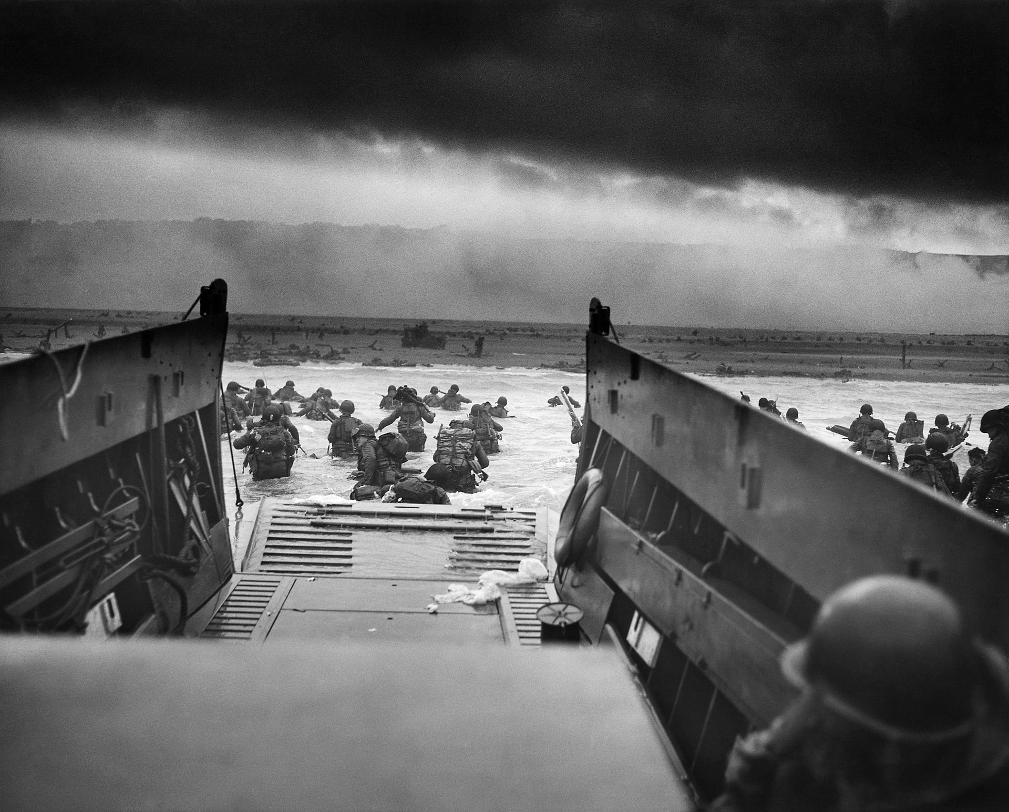
America in World War II
Notes:
https://commons.wikimedia.org/wiki/File:Row_of_men_at_the_New_York_City_docks_out_of_work_during_the_depression,_1934_-_NARA_-_518288.jpg#/media/File:Row_of_men_at_the_New_York_City_docks_out_of_work_during_the_depression,_1934_-_NARA_-_518288.jpg

Slide 3
Names and Terms You Should Know
Nazism
Adolf Hitler
League of Nations
Appeasement
Blitzkrieg
Neutrality Acts
Lend-Lease Act
Pearl Harbor
Home front
Mobilization
Wartime conversion
Rationing
Executive order
Japanese-American internment
Korematsu v. U.S.
A. Philip Randolph
Executive Order 8802
Integration
European Theater
Stalingrad
D-Day
Fall of Berlin
Pacific Theater
Battle of Midway
Manhattan Project
Atomic bomb
Hiroshima
Nagasaki
Nuremberg Trials
United Nations
Universal Declaration of Human Rights
Chapter 15: America in World War II

Slide 4
Standards Covered in this Chapter
SSUSH19 What were the origins, major developments, and the domestic impact of World War II?
What were the origins of U.S. entry in the war, including the Lend-Lease Act and the Japanese attack on Pearl Harbor?
What were the main events of the war in the Pacific Theater, including the difficulties that Americans faced in delivering weapons, food, and medical supplies to troops, the Battle of Midway, the Manhattan Project, and the dropping of two atomic bombs on Japan?
What were the main events of the war in the European Theater, including the difficulties that Americans faced in delivering weapons, food, and medical supplies to their troops, the Allied landing on the beaches of Normandy on D-Day, and the fall of Berlin?
What was the domestic impact of the war, including wartime mobilization, rationing, wartime conversion, and the role of women and African Americans in the war effort?
Was Roosevelt’s use of executive powers during the war justified, including his executive orders for the integration of workers in the defense industries and for the relocation and internment of Japanese Americans living along the West Coast?

Slide 5
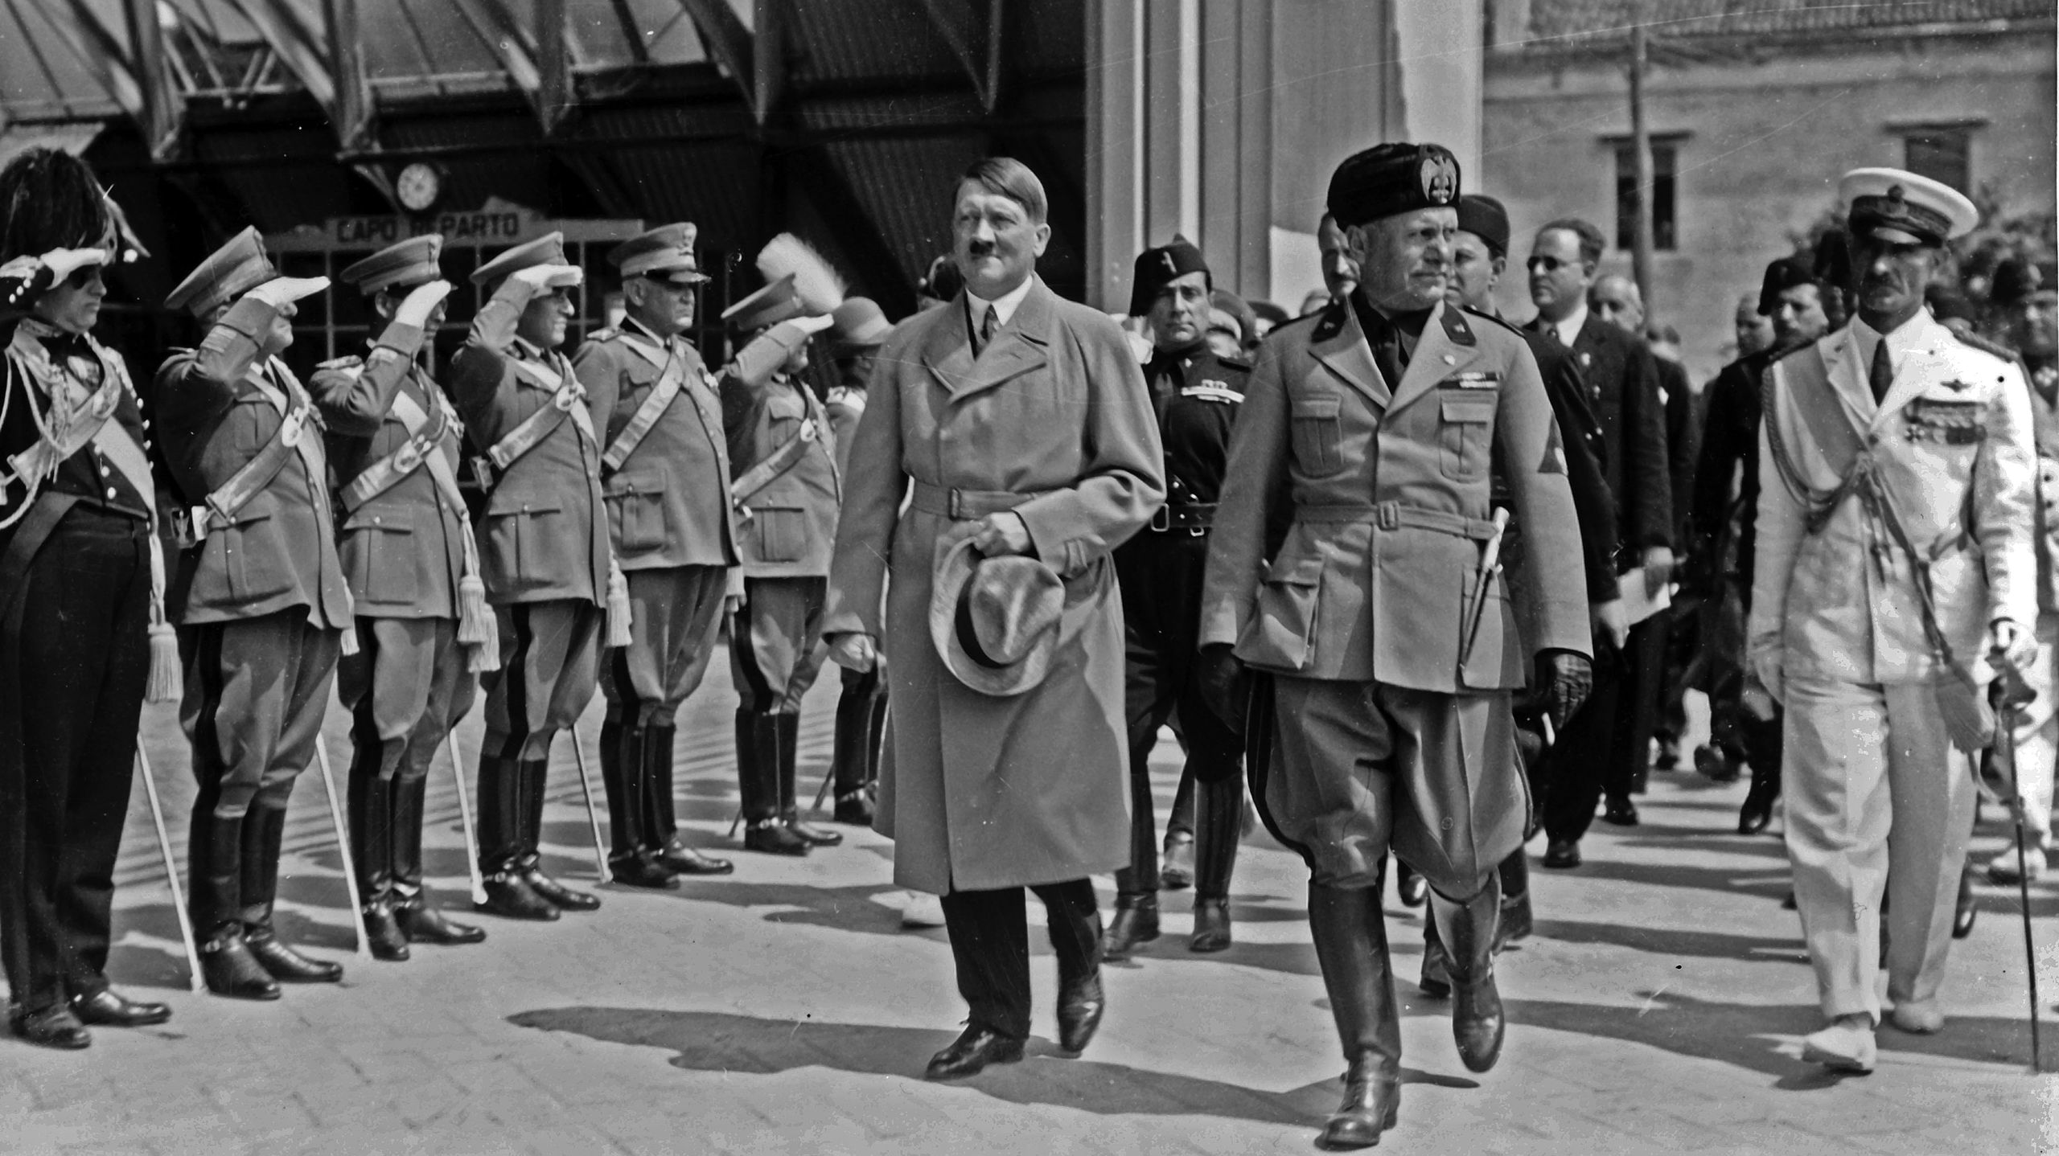
The Origins of World War II in Europe

Slide 6
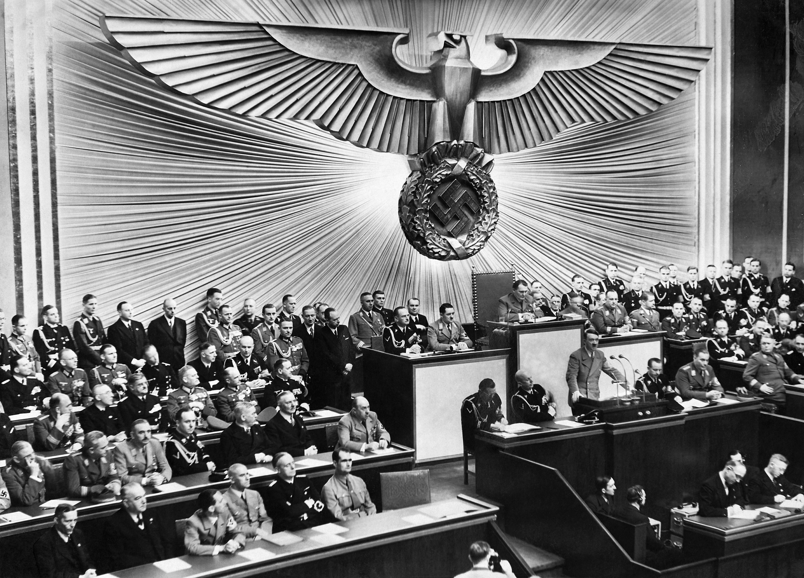
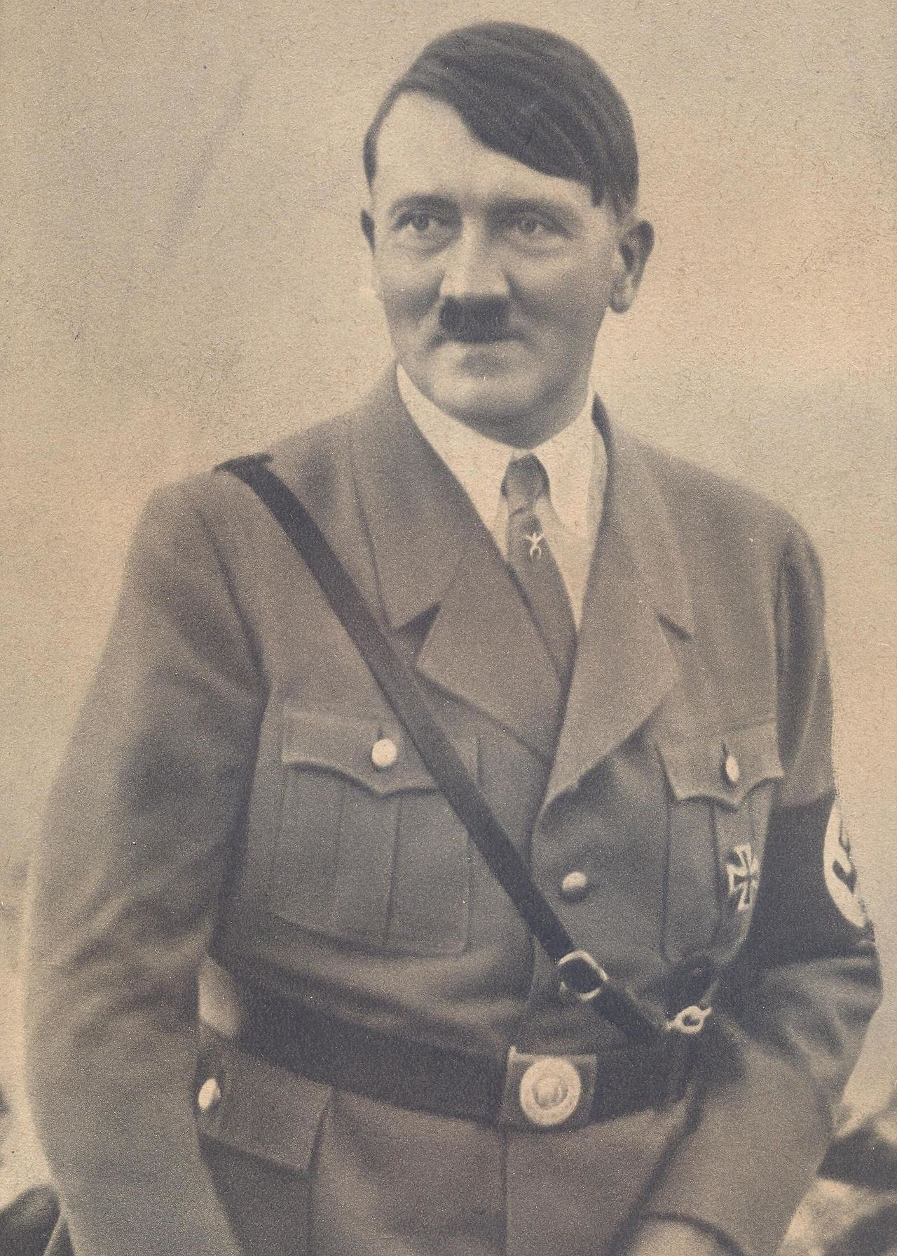
The Rise of Dictatorships in Europe
Nazism in Germany— Adolf Hitler
Nationalistic
Warlike/Violent
Obedience to Leader
Belief in superiority of Aryan race
Anti-Semitism

Slide 7
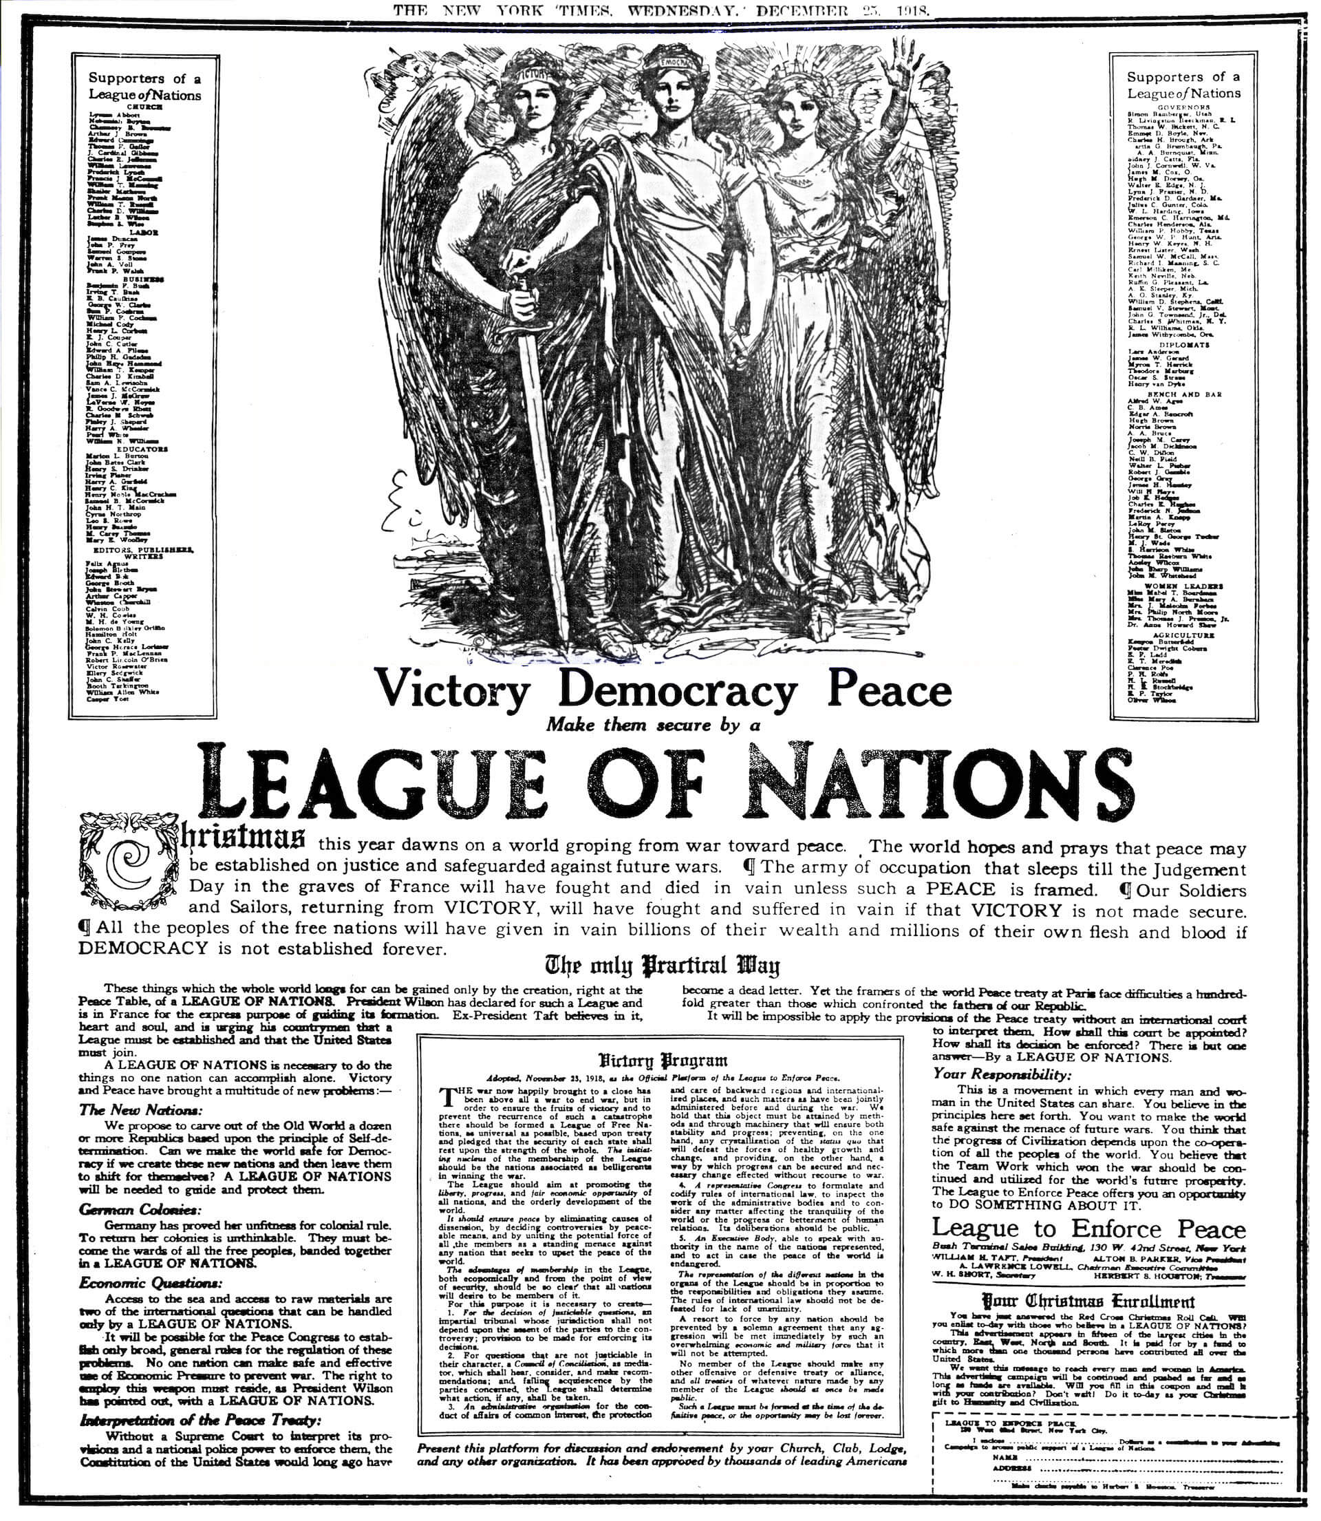
The Failure of the League of Nations | The Failure of Appeasement
The League of Nations and the appeasement policy of Britain and France failed to stop Hitler’s aggressive acts.

Slide 8
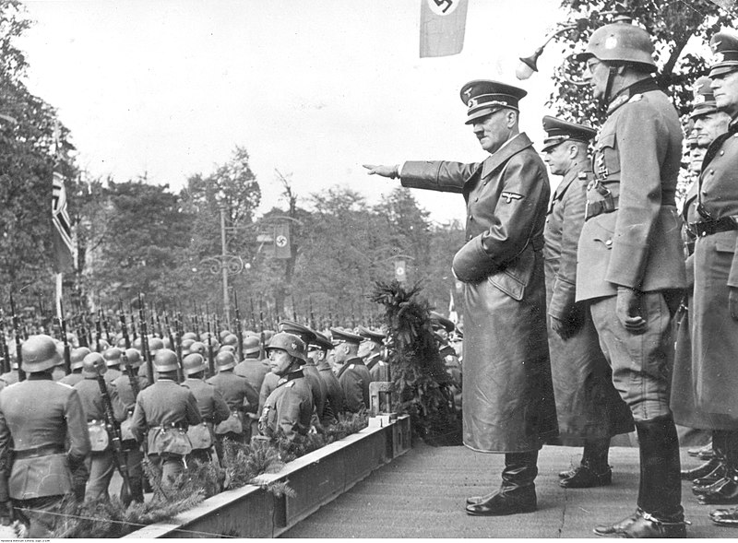
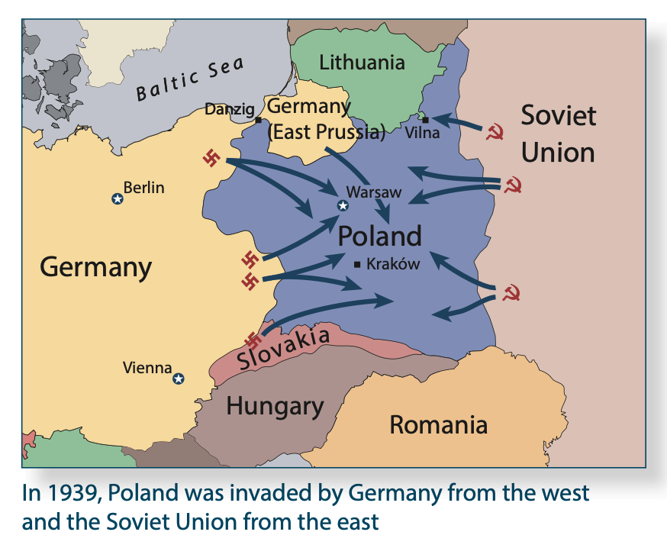
World War II Begins: The German Invasion of Poland
In September 1939, Germany invaded Poland from the west, while the Soviet Union invaded Poland from the east.
Britain and France responded by declaring war on Germany, and World War II began in Europe.
German troops parade in Warsaw in 1939

Slide 9
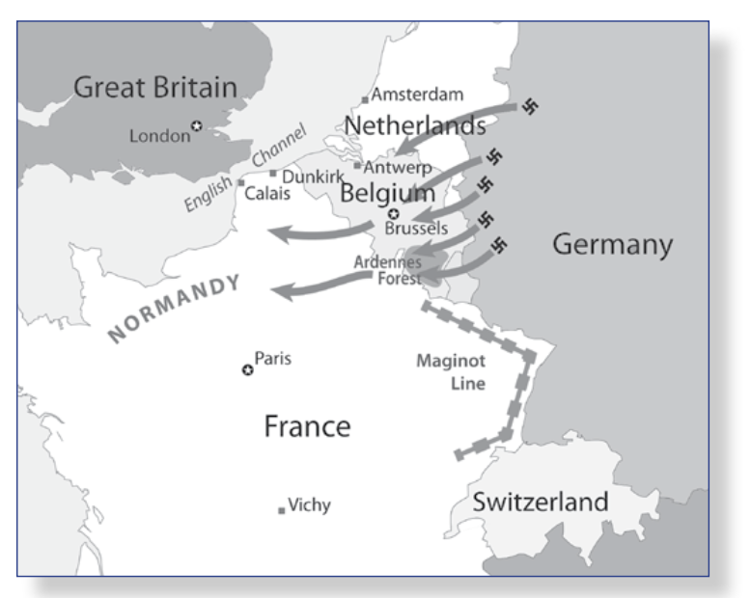
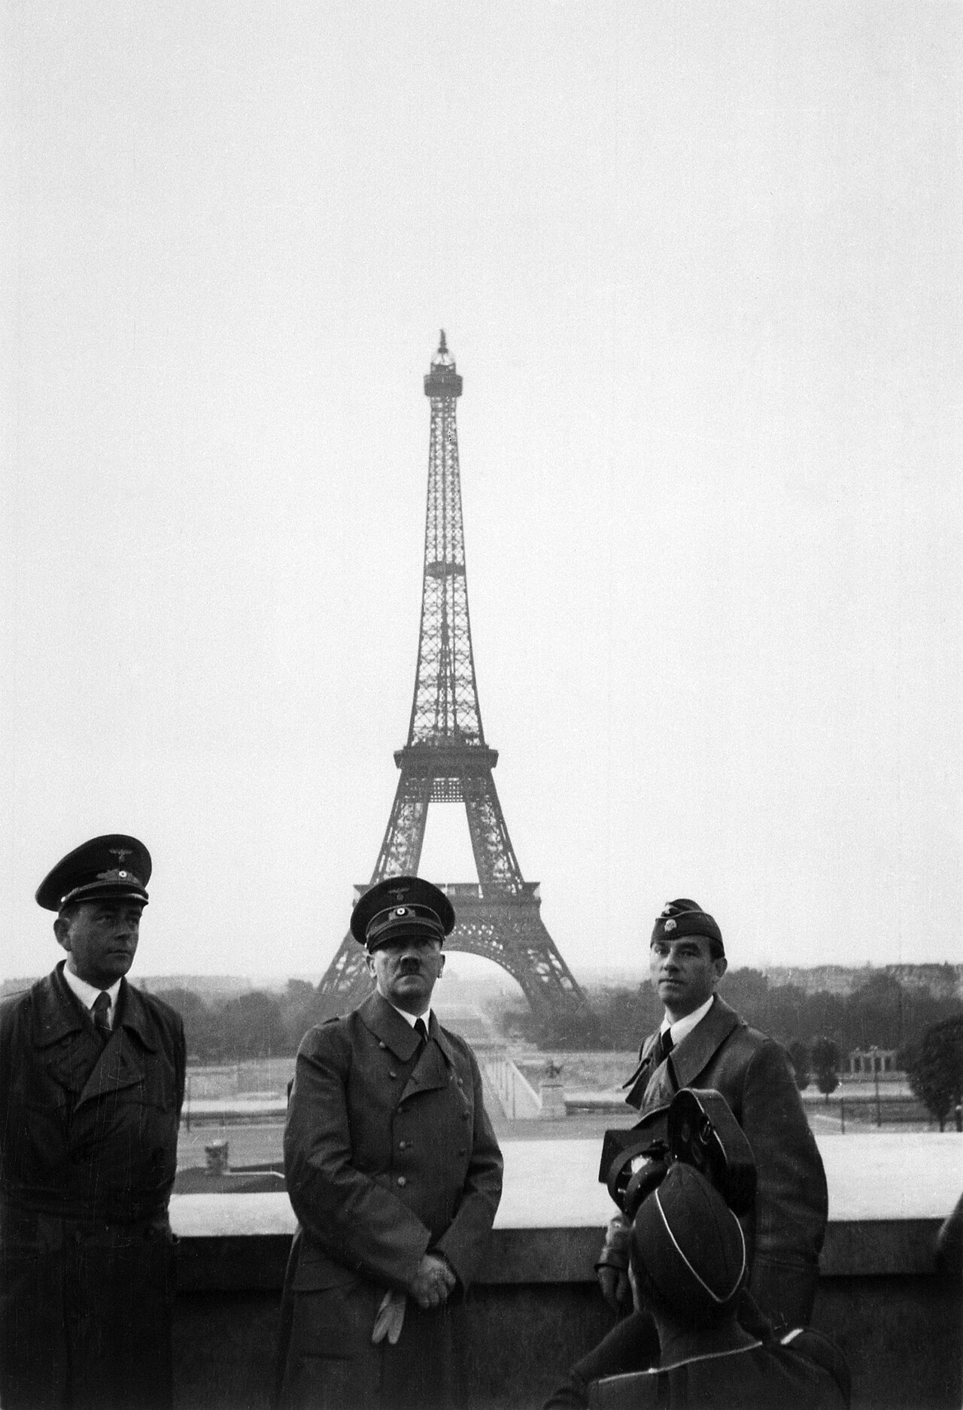
The Fall of France
During the first months of 1940, Western Europe remained quiet.
Then in April, Germany invaded Denmark and Norway; in May, the Germans attacked the Netherlands, Belgium, Luxembourg, and France.
German troops avoided the strong French fortifications built along the border between France and Germany by marching through the Ardennes Forest and across Belgium.
By June 1940, the French were forced to surrender.
The advance of the German army and the defeat of France in June 1940
Adolf Hitler standing on the terrace of the Palais de Chaillot, dated June 23, 1940.

Slide 10
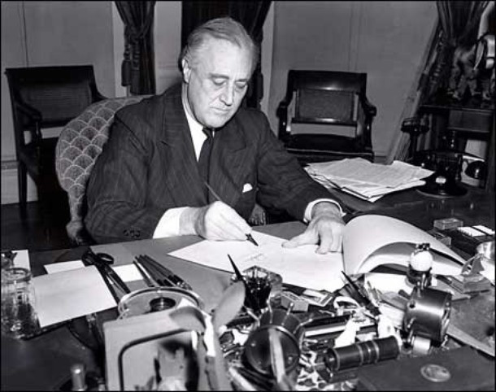
America Maintains Neutrality

Slide 11
The Neutrality Acts of 1935–1937
The Neutrality Acts of 1935–1937 aimed at keeping the United States out of the war.
The Neutrality Act of 1937 allowed Americans to sell non-military goods to countries at war on a “cash-and-carry” basis.
The Neutrality Act of 1939 expanded “cash-and-carry” to include the sale of arms.

Slide 12
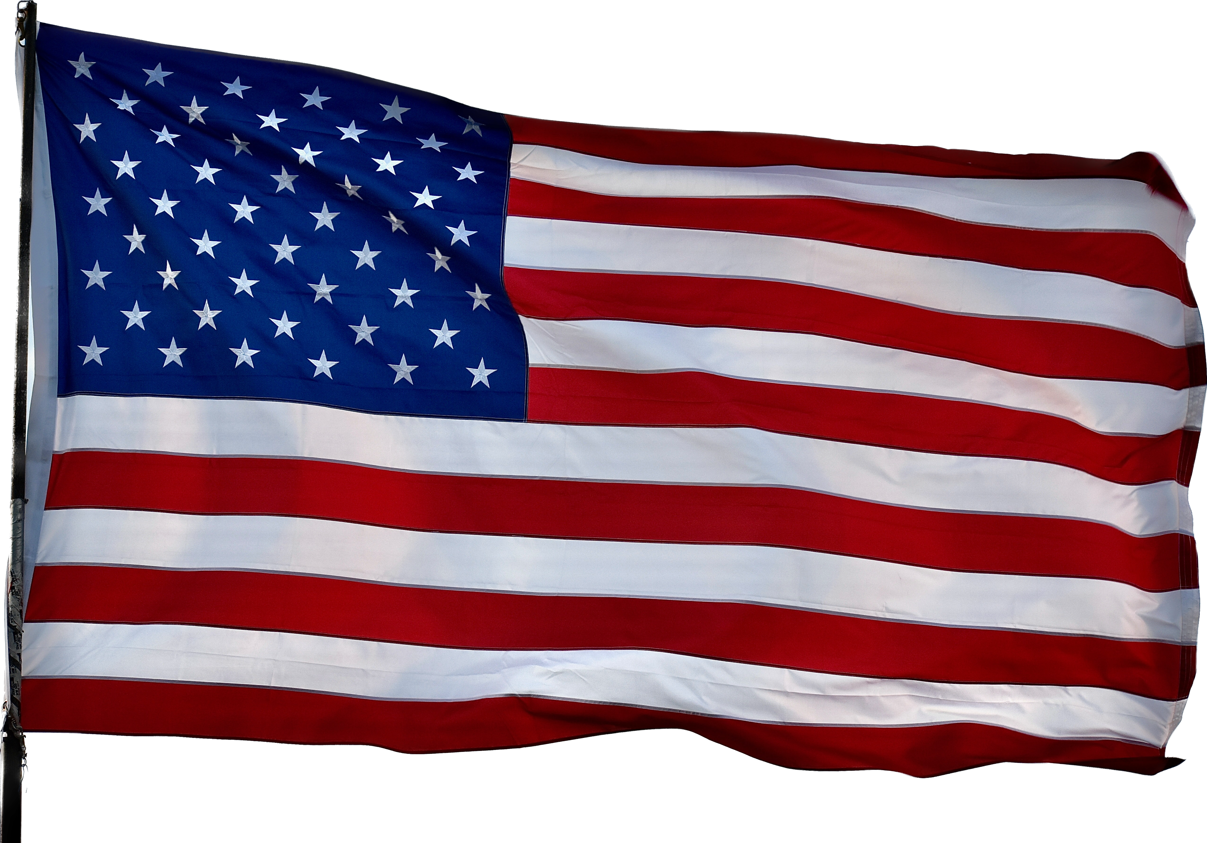
The Lend-Lease Act of 1941
In 1941, Roosevelt pushed “Lend-Lease” through Congress: the United States could supply the British with arms, to be paid for or returned after the war.
In March 1941, President Roosevelt signed a Lend-Lease bill to help Britain and China.

Slide 13
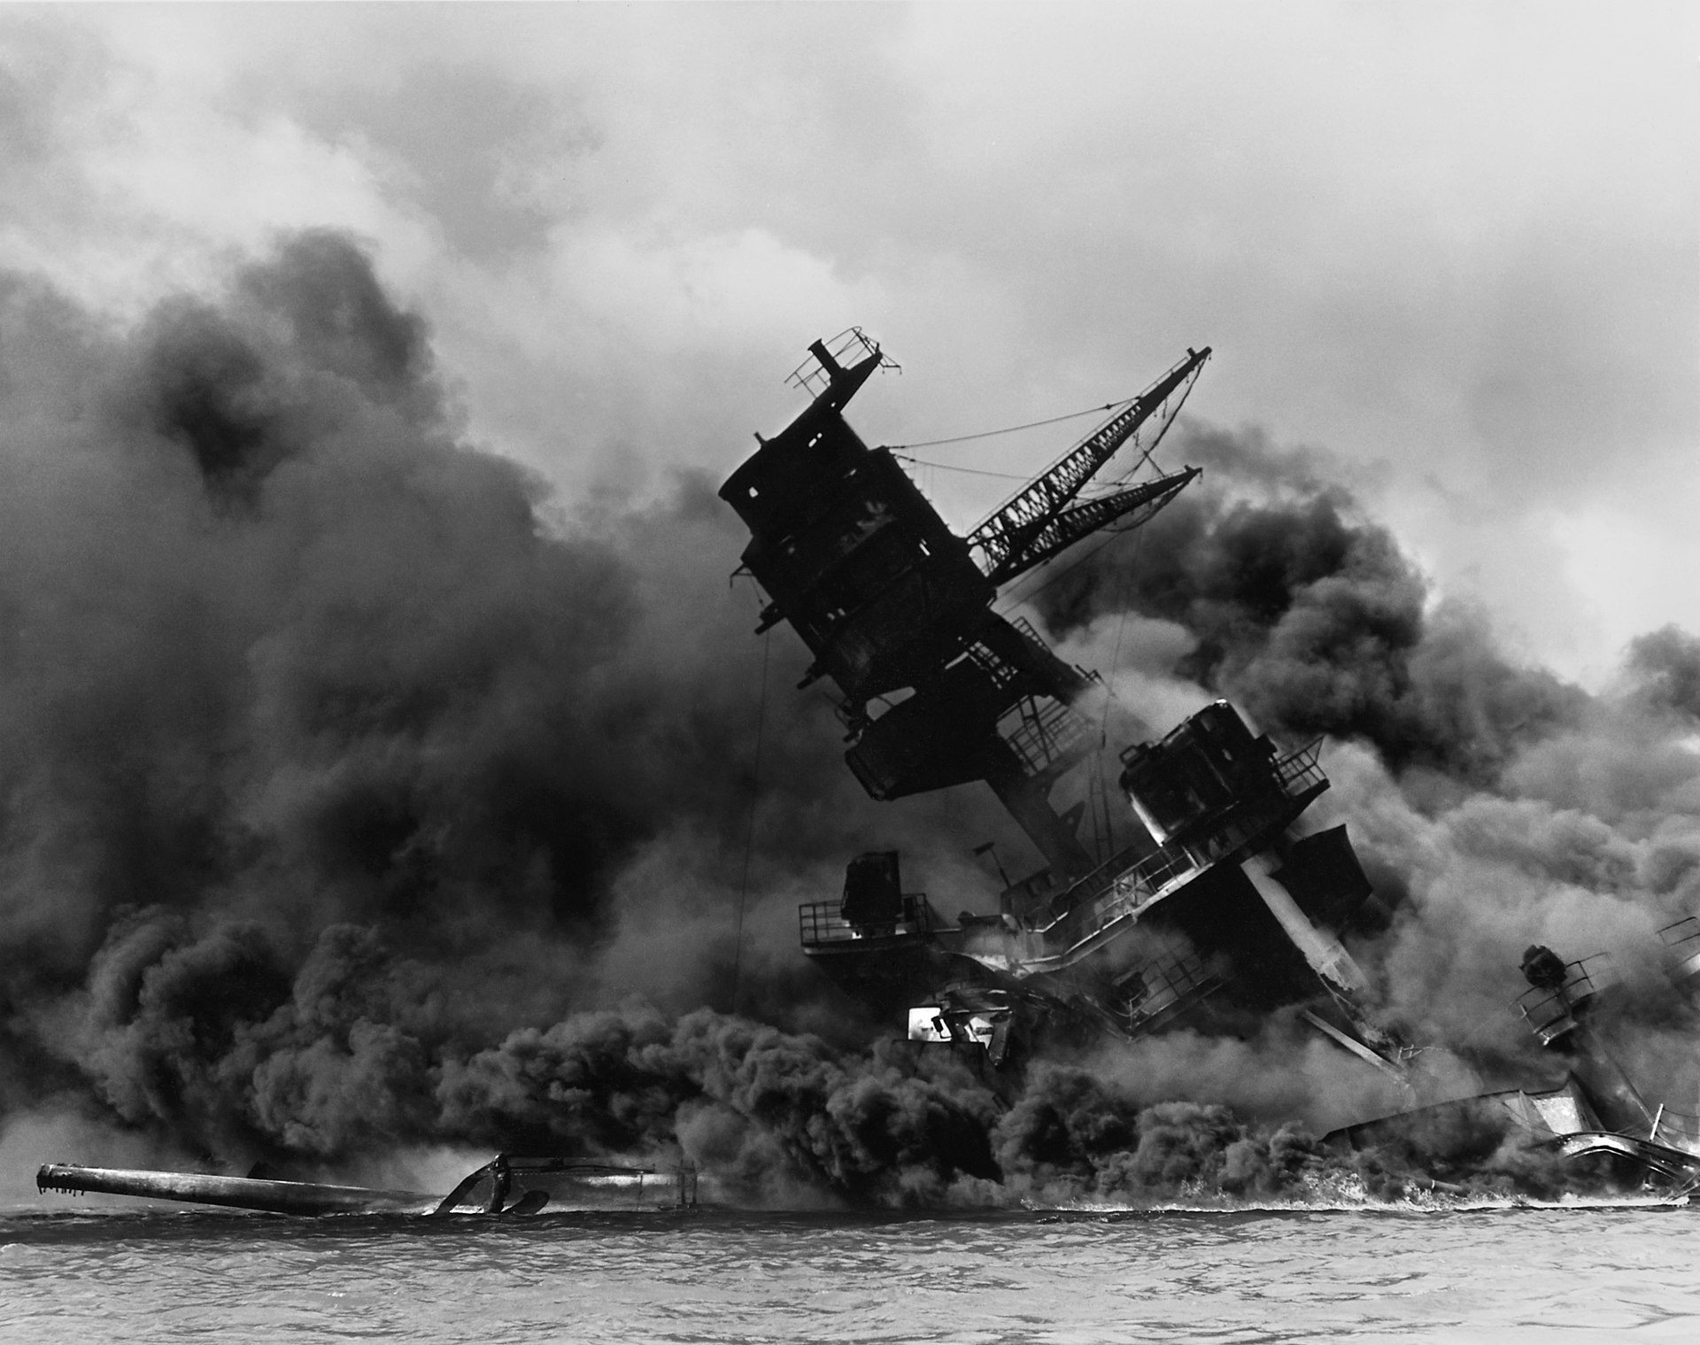
The Japanese Attack on Pearl Harbor

Slide 14
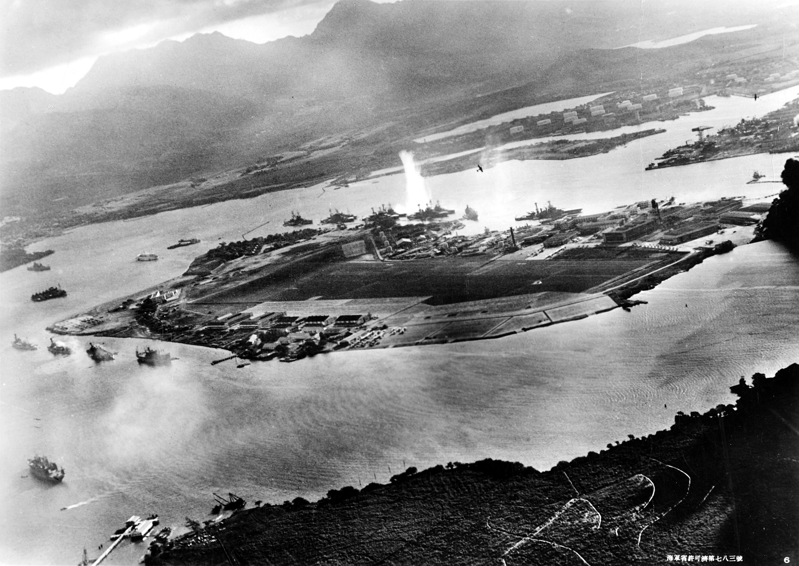
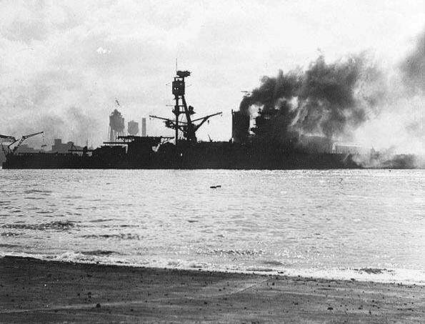
The Attack at Pearl Harbor
The United States threatened to boycott Japan and cut off its supply of oil, leading the Japanese to launch a surprise attack on the U.S. Navy at Pearl Harbor in Hawaii on December 7, 1941. The attack on Pearl Harbor brought the United States into the war.
Japanese airplanes bomb the U.S. naval fleet at Pearl Harbor.

Slide 15
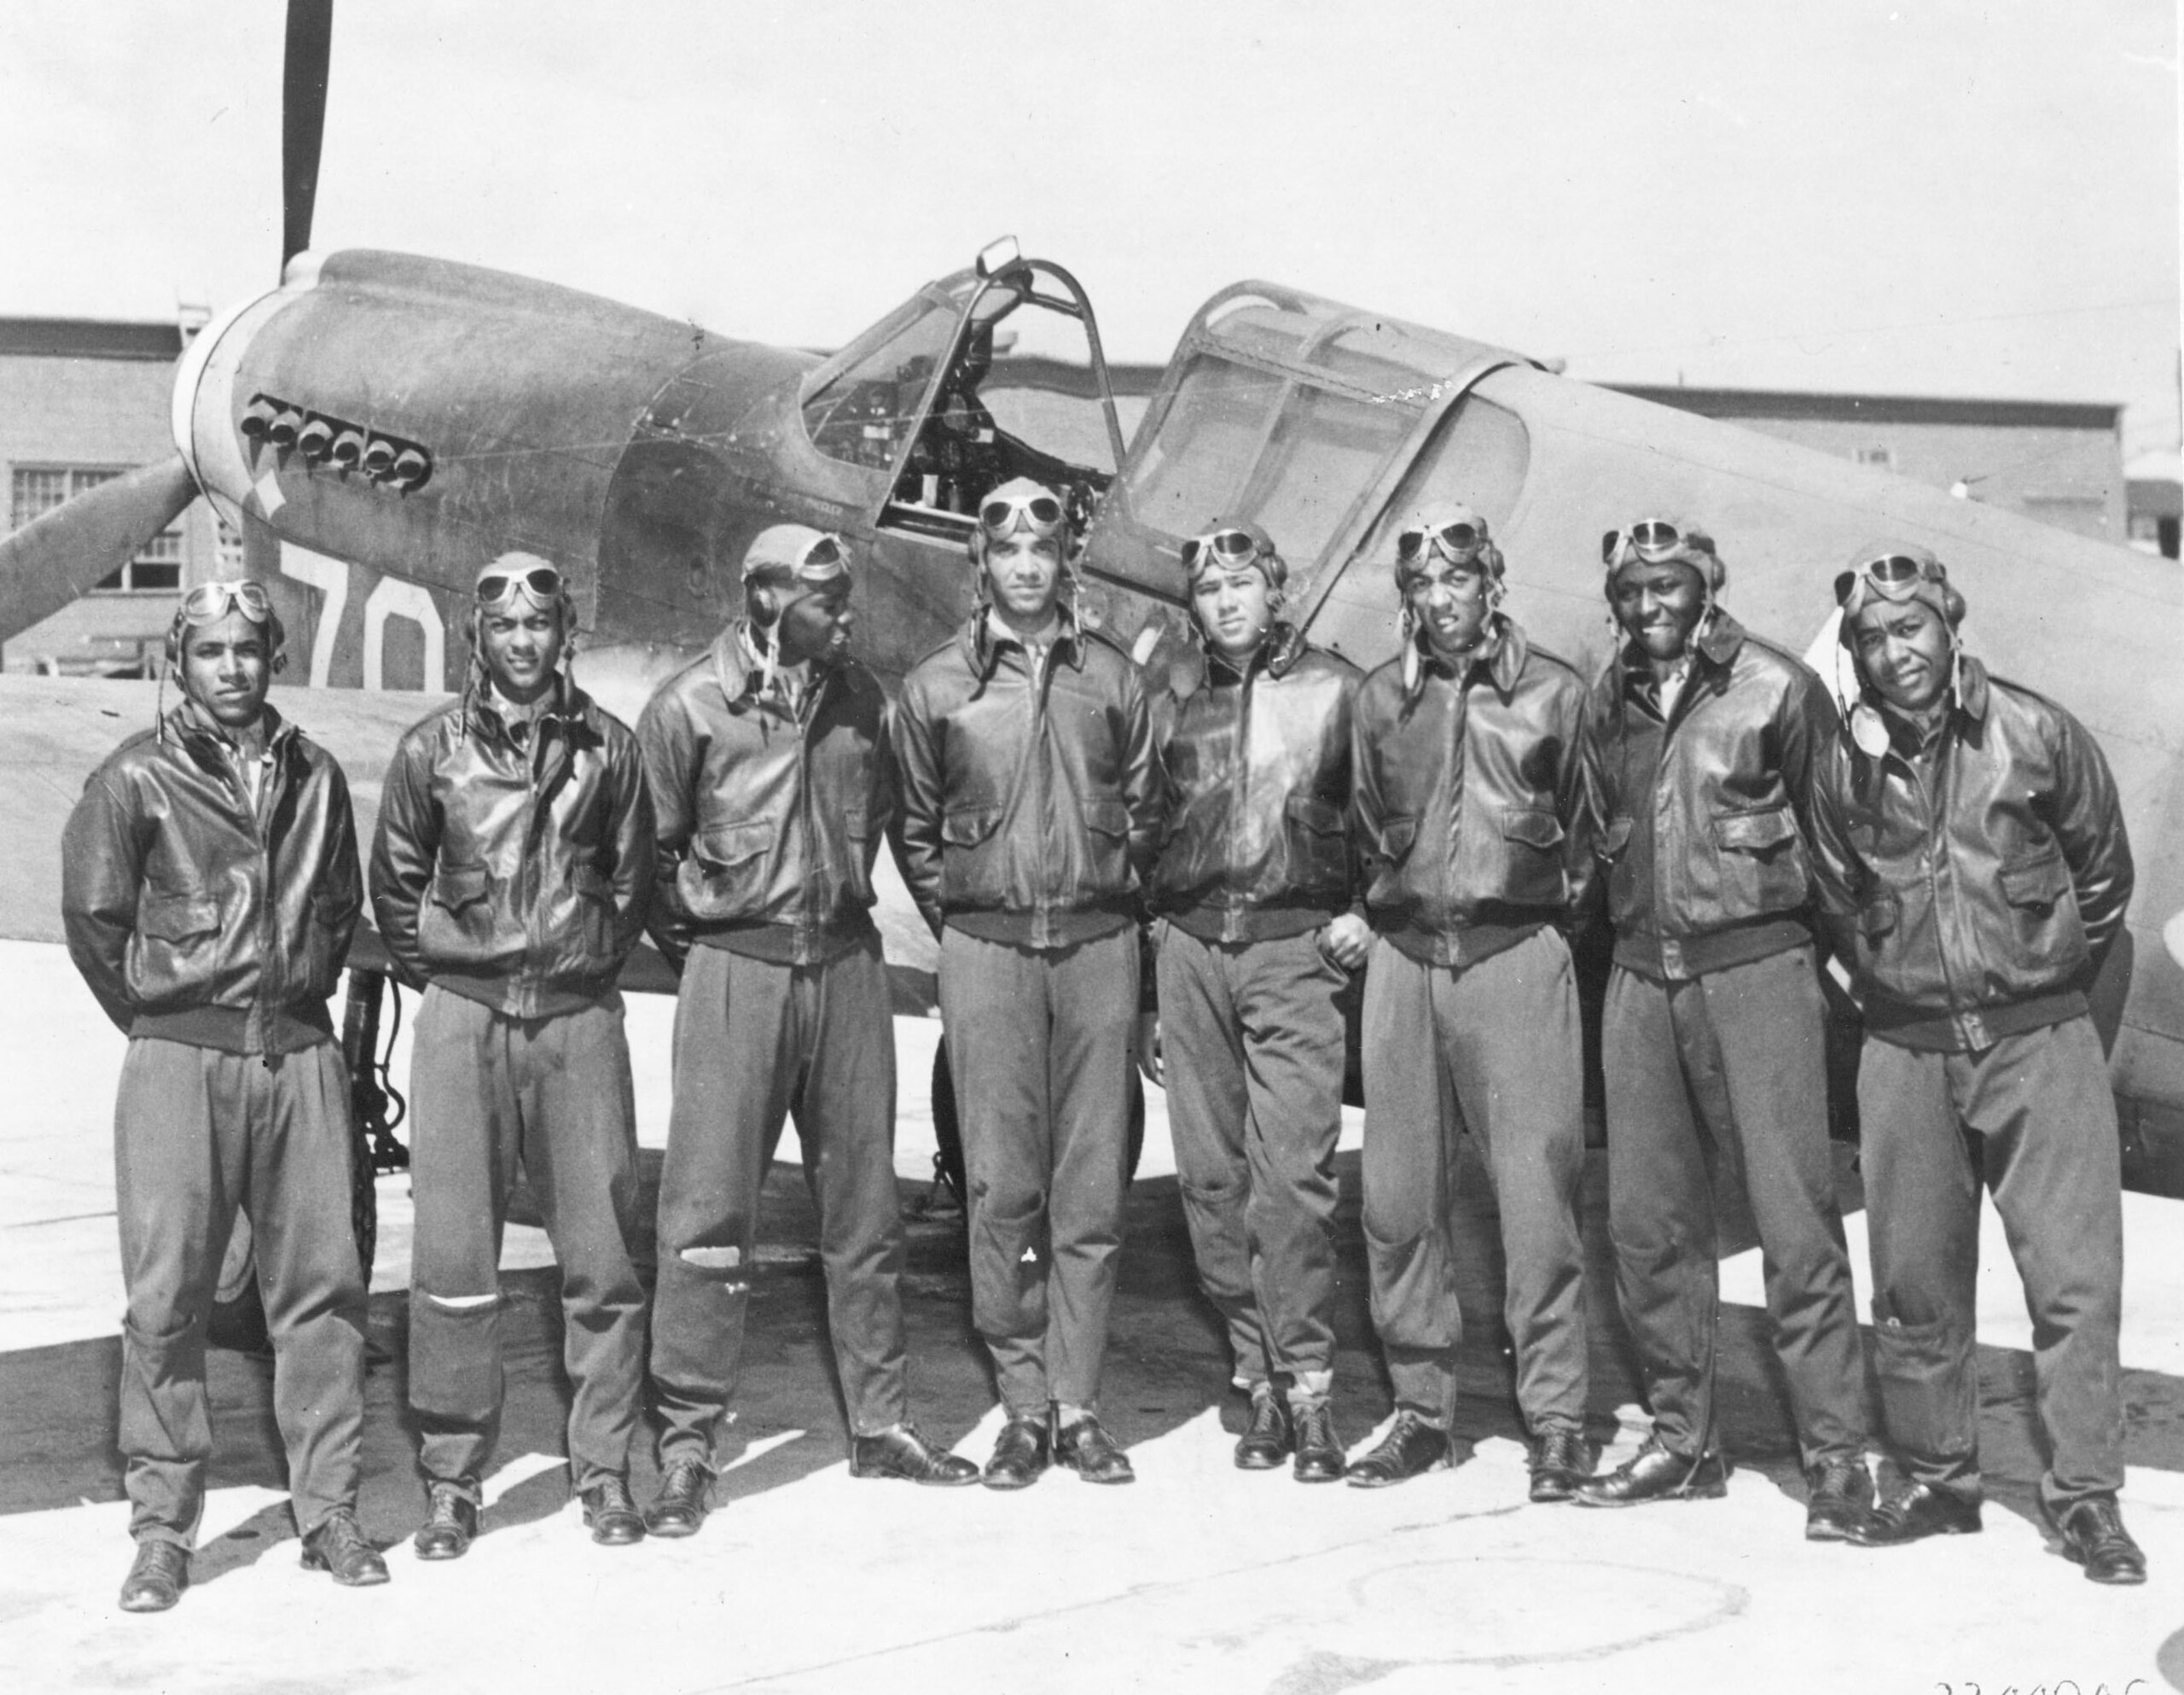
The United States at War: Mobilization on the Home Front

Slide 16
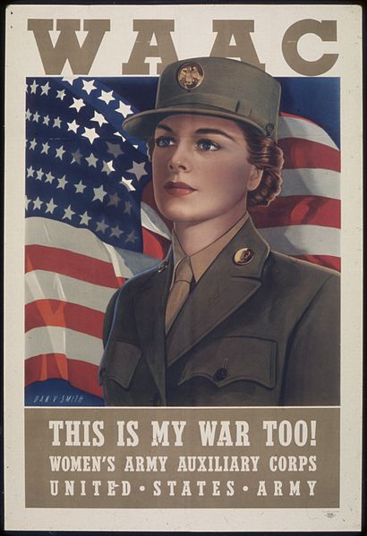
The Draft
Americans now mobilized for war. The United States extended the draft to all able-bodied males of the ages 18–45.
For the first time, women were also permitted to enlist. The Women’s Army Corps, or “WACs,” was established in 1942.
The Tuskegee Airmen, a unit of African-American fighter pilots, flew more than 1,500 missions in Europe.
Tuskegee Airmen

Slide 17
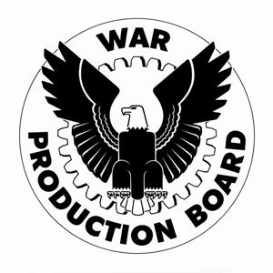
Wartime Conversion and Production
The War Production Board was set up to ease the conversion (change) from peacetime to wartime production. A hundred billion dollars in government contracts were awarded to private industry within the first six months of the war.
Food was desperately needed by American troops, by the Allies in Europe, and by American consumers. Crop prices rose, helping farmers. Farm production increased based on improved techniques and the cultivation of new areas.
Victory garden poster

Slide 18
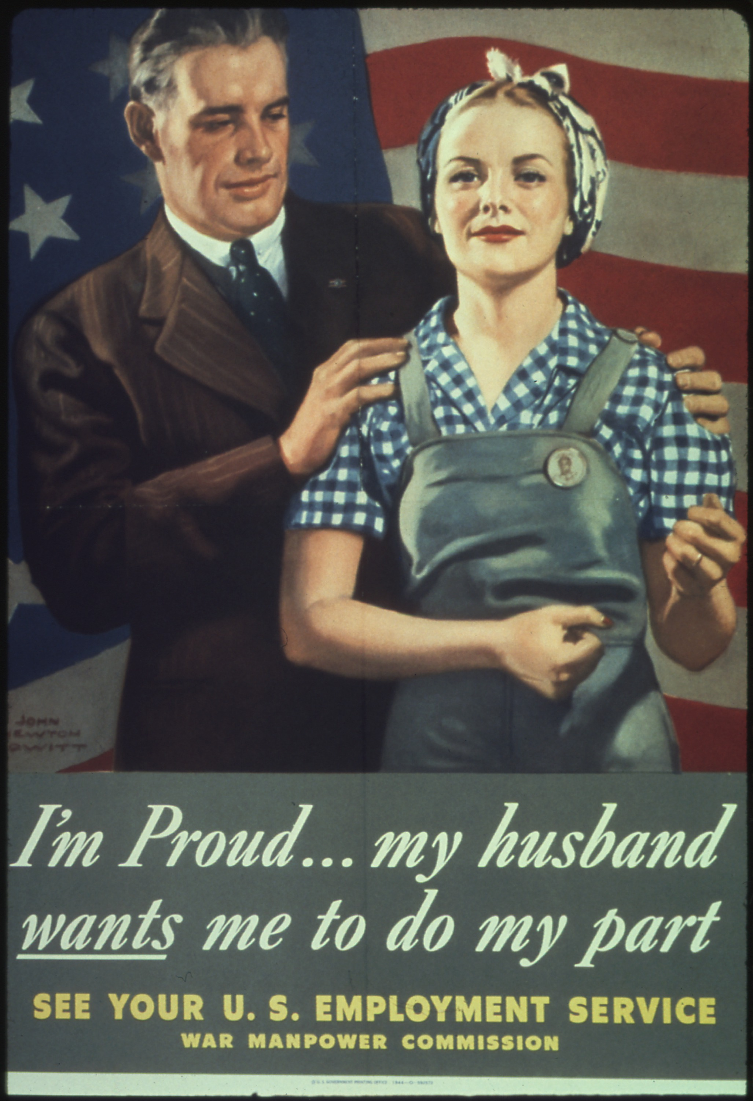
Information and Propaganda
The federal government made efforts to control the flow of information and maintain popular support.
The Office of War Information (OWI) created posters, censored newsreels and even produced its own radio programs to promote patriotism and boost the war effort.

Slide 19
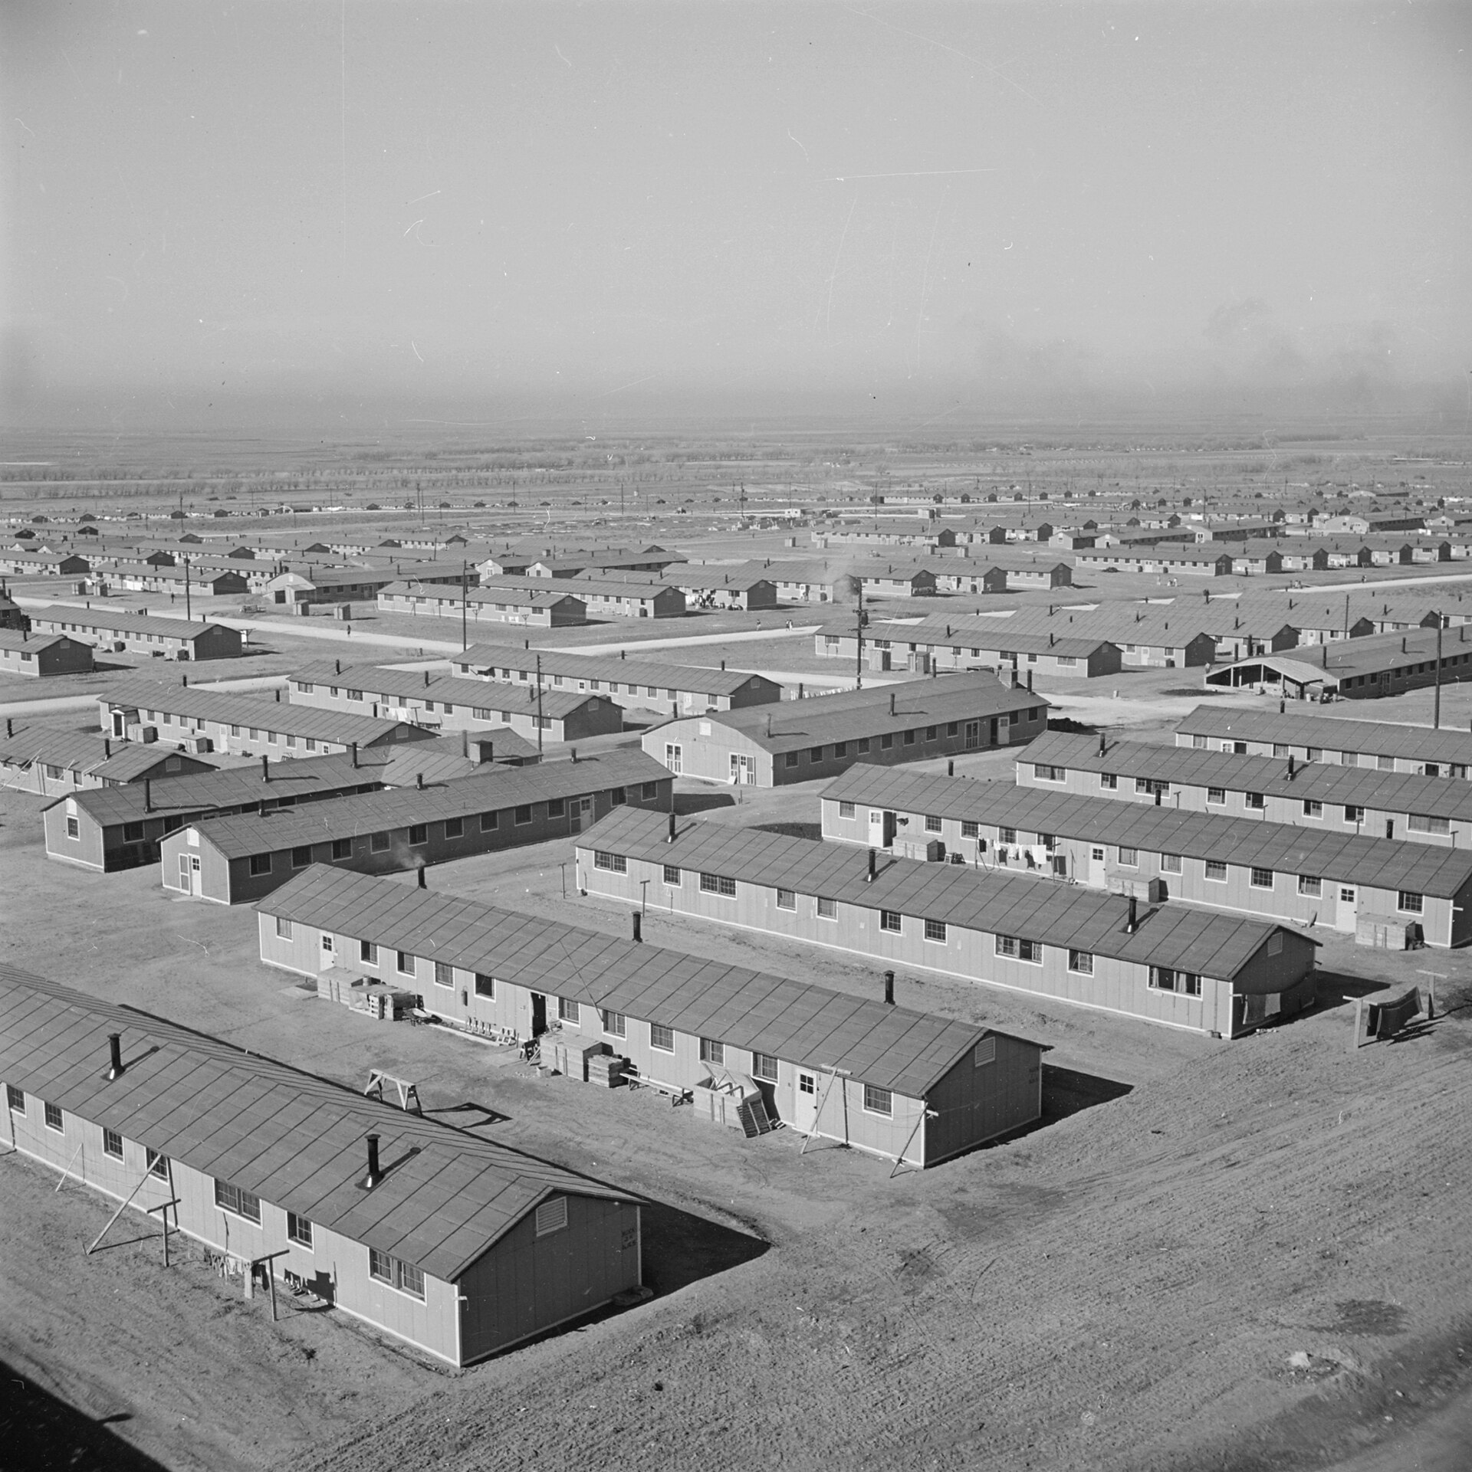
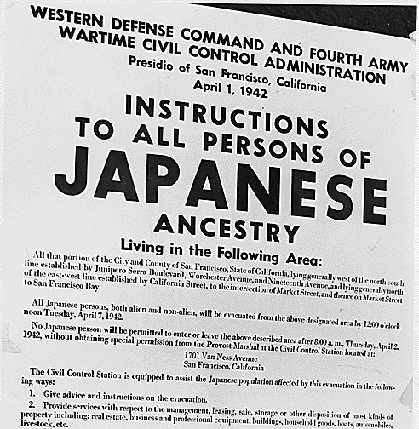
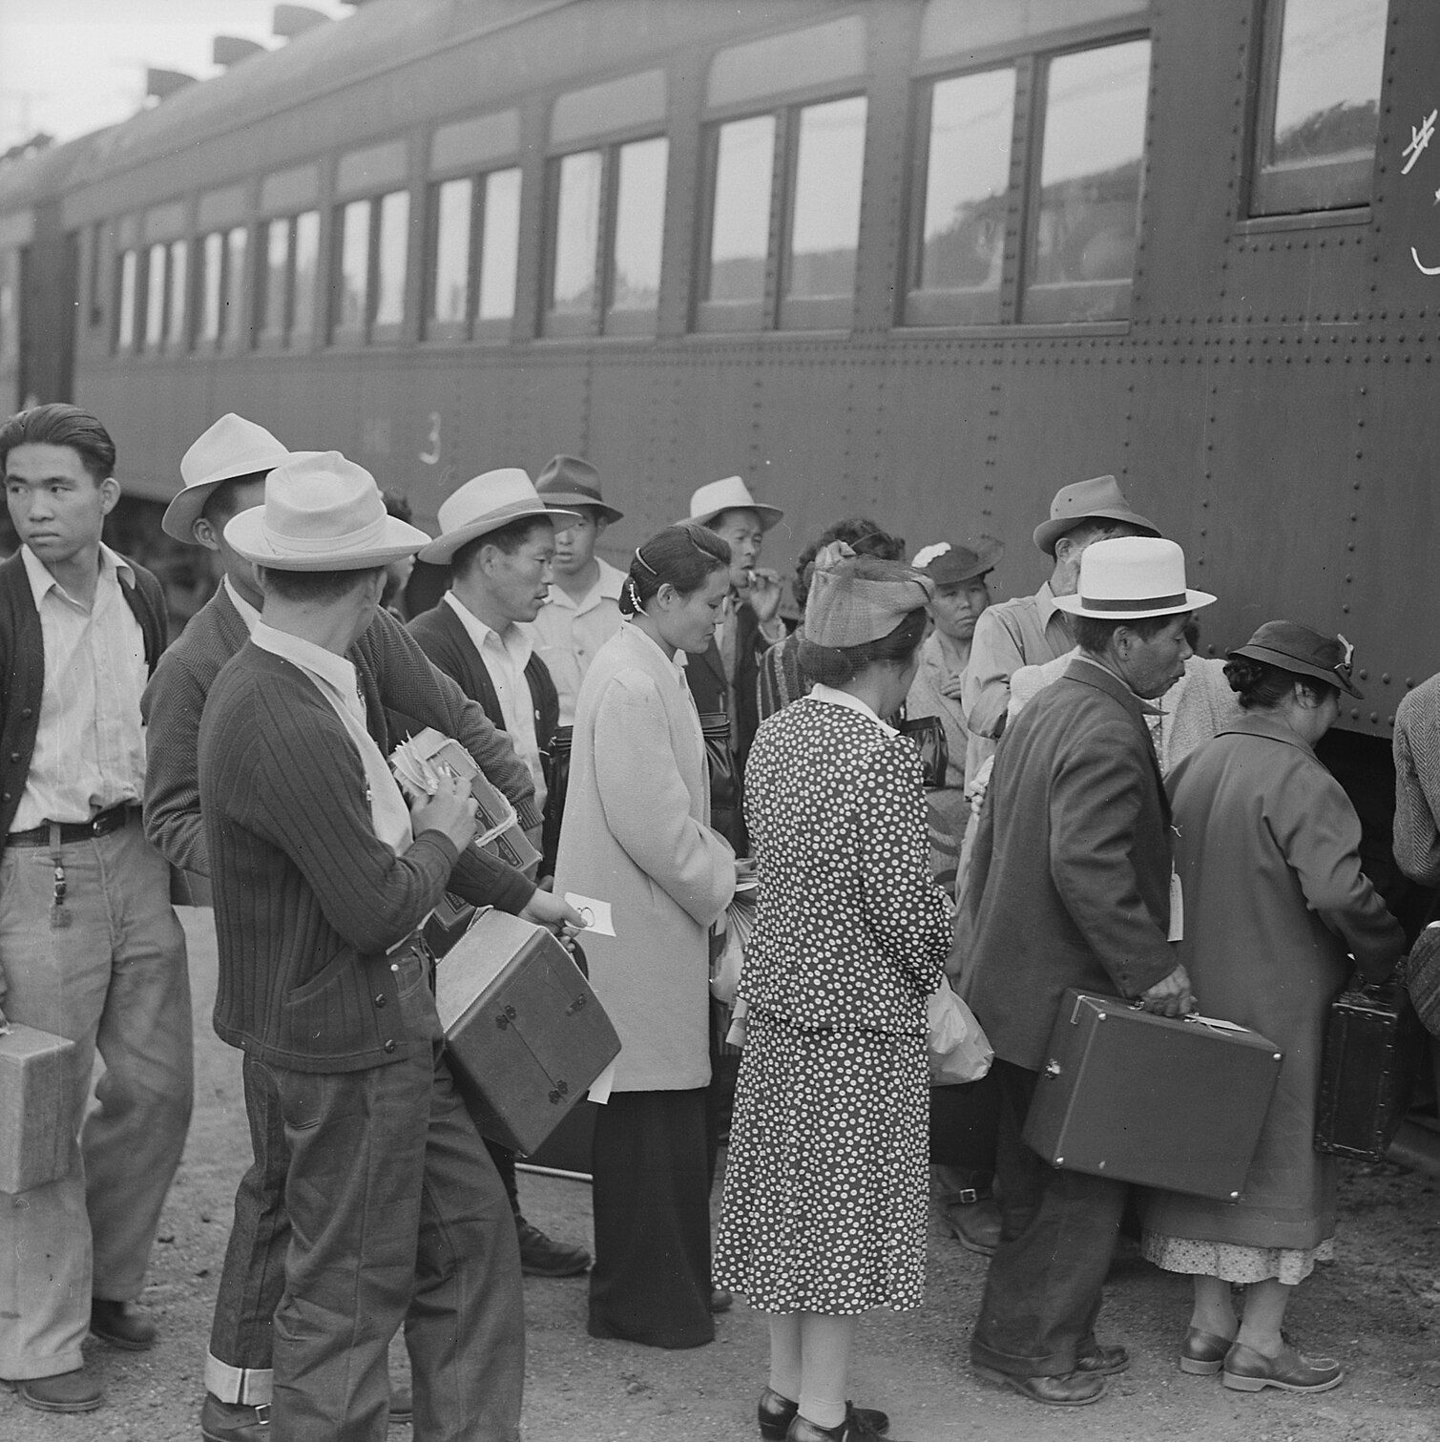
The Internment of Japanese Americans
Many Americans on the West Coast feared that Japanese Americans, despite being loyal for generations, would commit acts of espionage or sabotage on behalf of Japan. Roosevelt justified this forced relocation as a military necessity even though there was no actual evidence of acts of disloyalty.

Slide 20
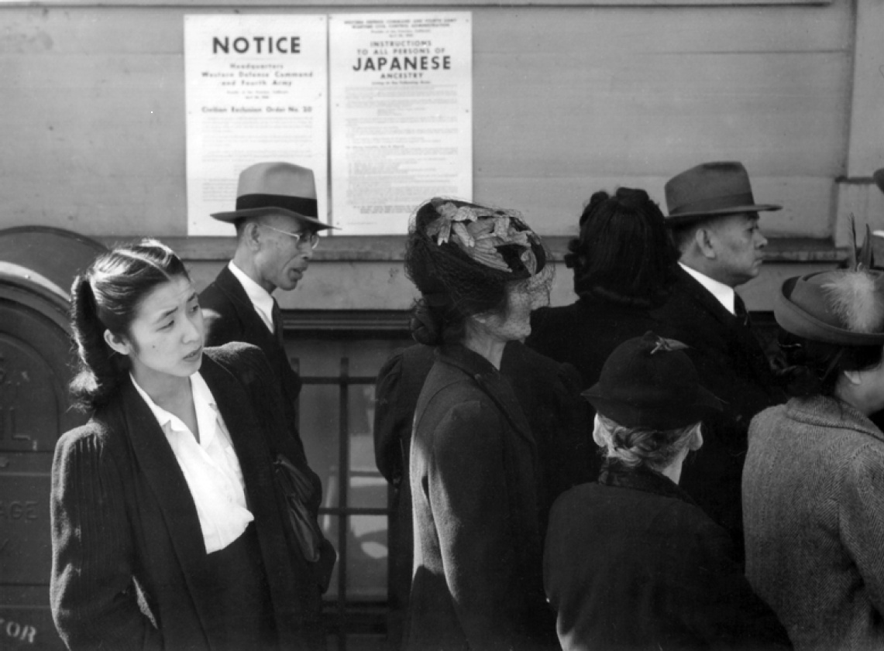
Korematsu v. United States
President Roosevelt signed Executive Order 9066, relocating Japanese Americans within 100 miles of the Pacific Coast to inland internment camps. The order was upheld by the Supreme Court in the case of Korematsu v. United States (1944).

Slide 21
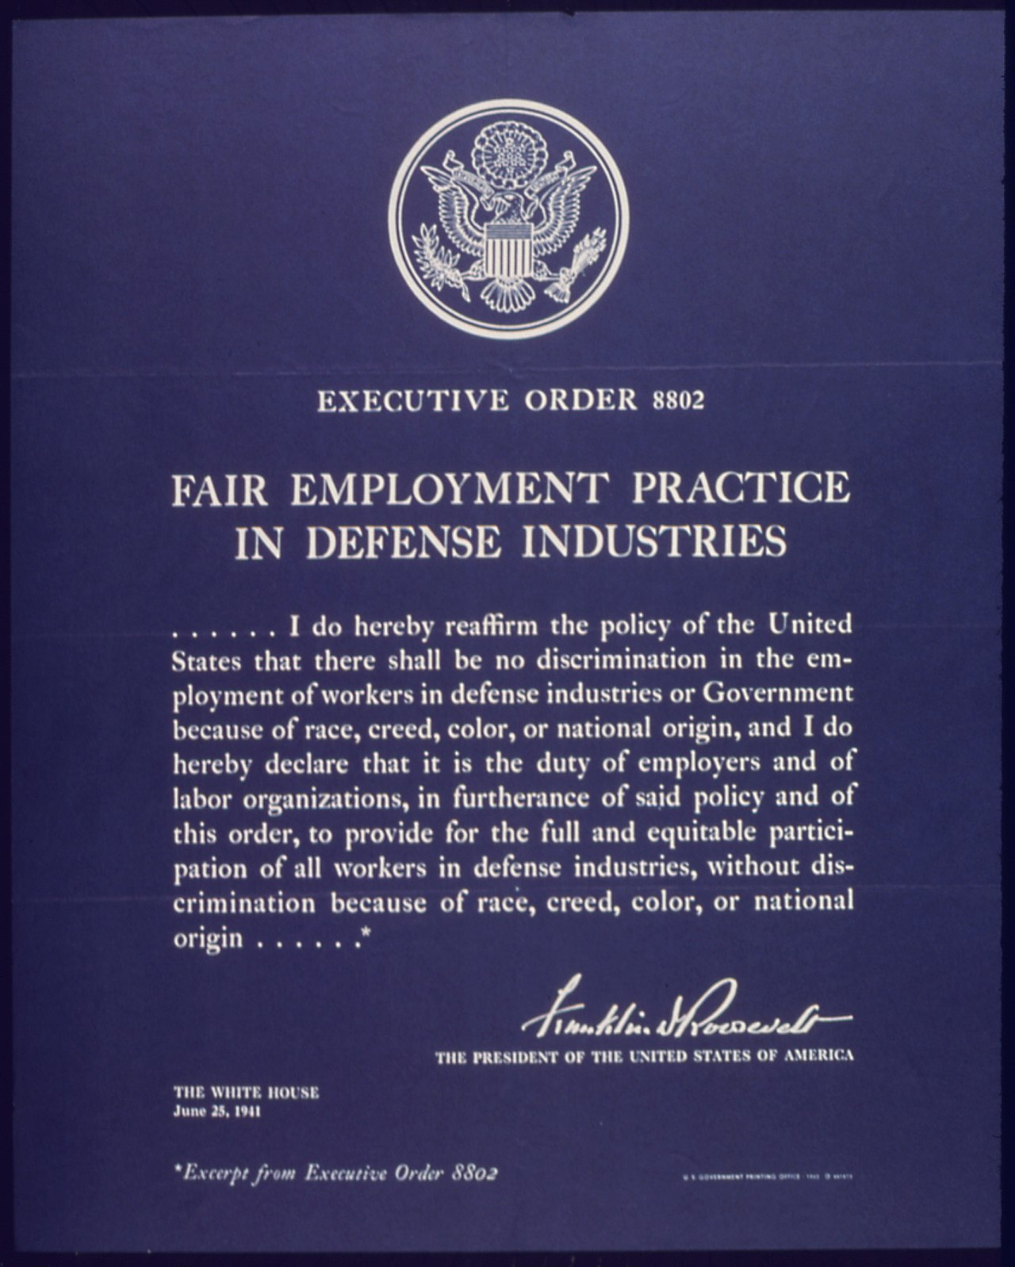
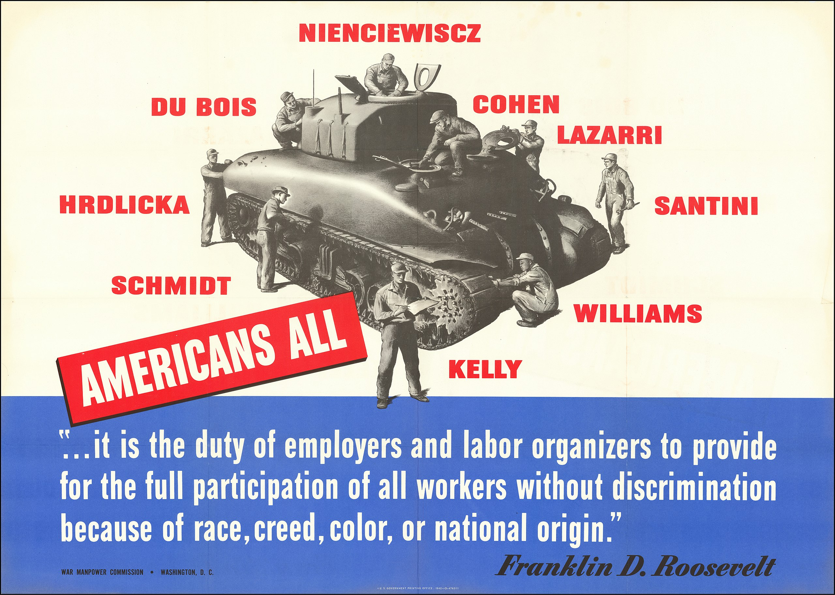
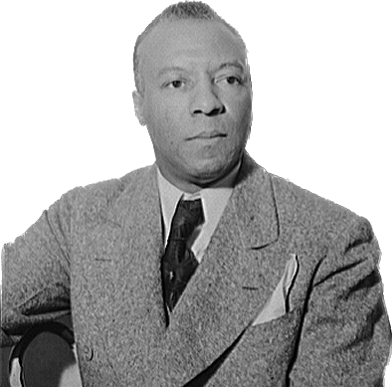
Racial Integration of the Defense Industries
When civil rights leader A. Philip Randolph planned a “March on Washington” to support jobs for African Americans, President Roosevelt signed Executive Order 8802, throwing federal jobs and jobs with federal contractors open to African Americans.
A. Philip Randolph

Slide 22
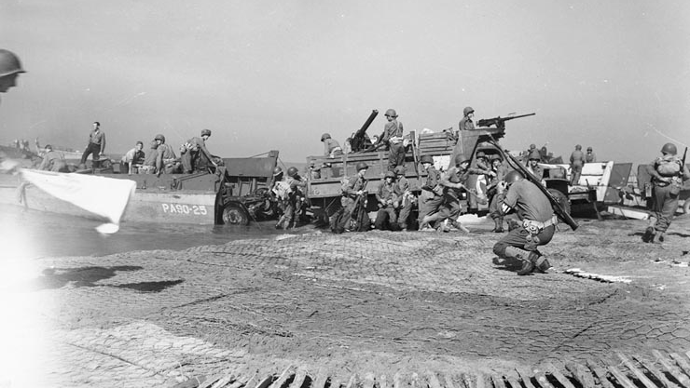
The European Theater: The War against Germany

Slide 23
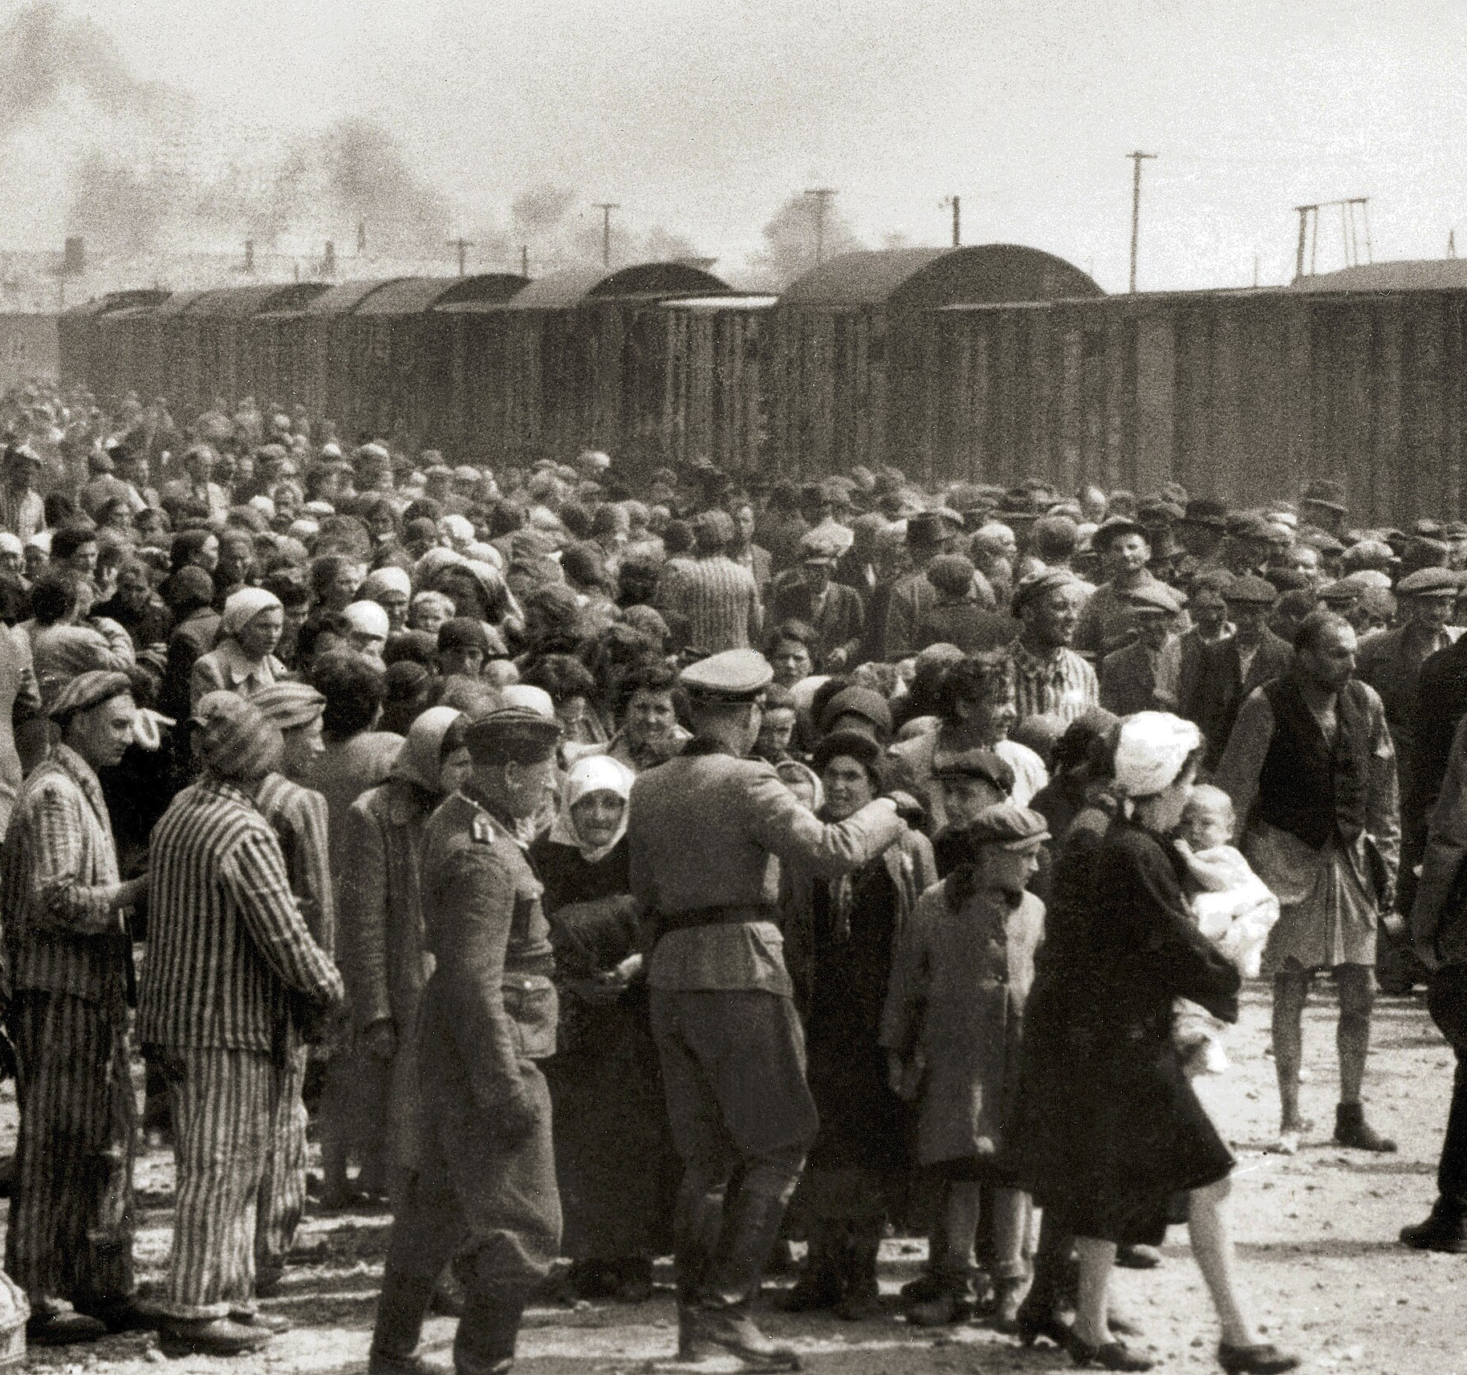
Hitler’s Plans and the Holocaust
Nazi Germany murdered European Jews in the Holocaust. Trains carried Jews and other victims to Auschwitz and other extermination camps.

Slide 24
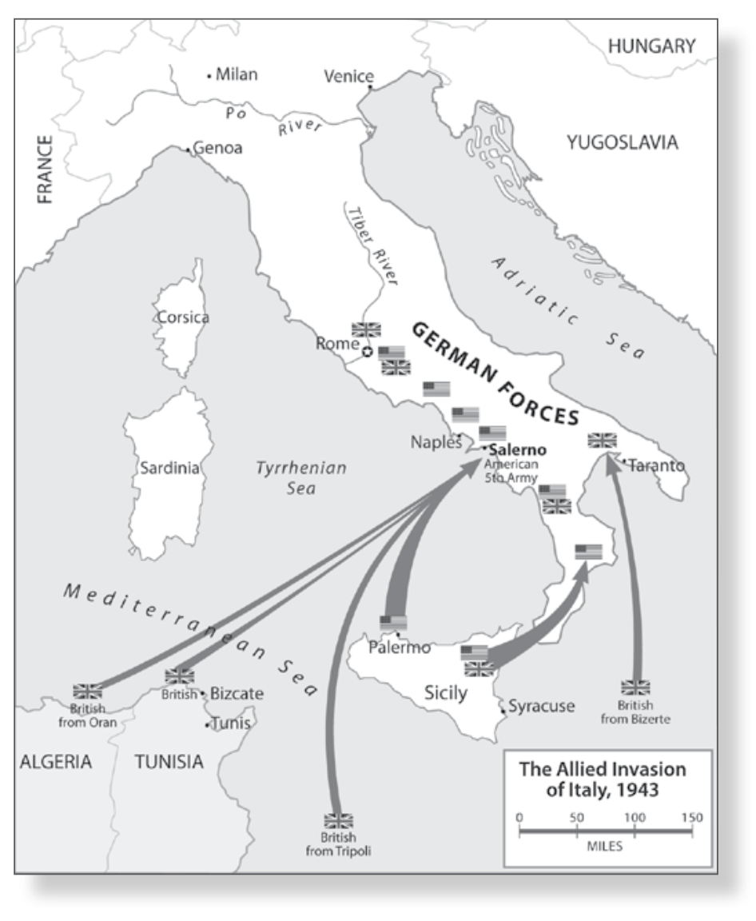
North Africa and Italy
Americans and British delayed opening a second major front in Western Europe while the Soviets faced most of the German army; instead Americans and British sent troops to North Africa, Sicily, and Italy.

Slide 25
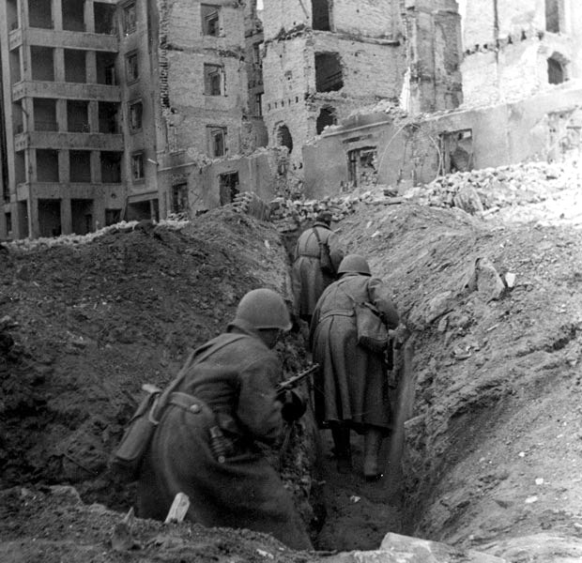
Stalingrad
German and Soviet troops had been locked in deadly combat in the city of Stalingrad in the Soviet Union (August 1942–January 1943).
This battle proved to be the turning point of the war in Europe.
By this time, the Soviet army had developed new tactics to counter German Blitzkrieg warfare.

Slide 26
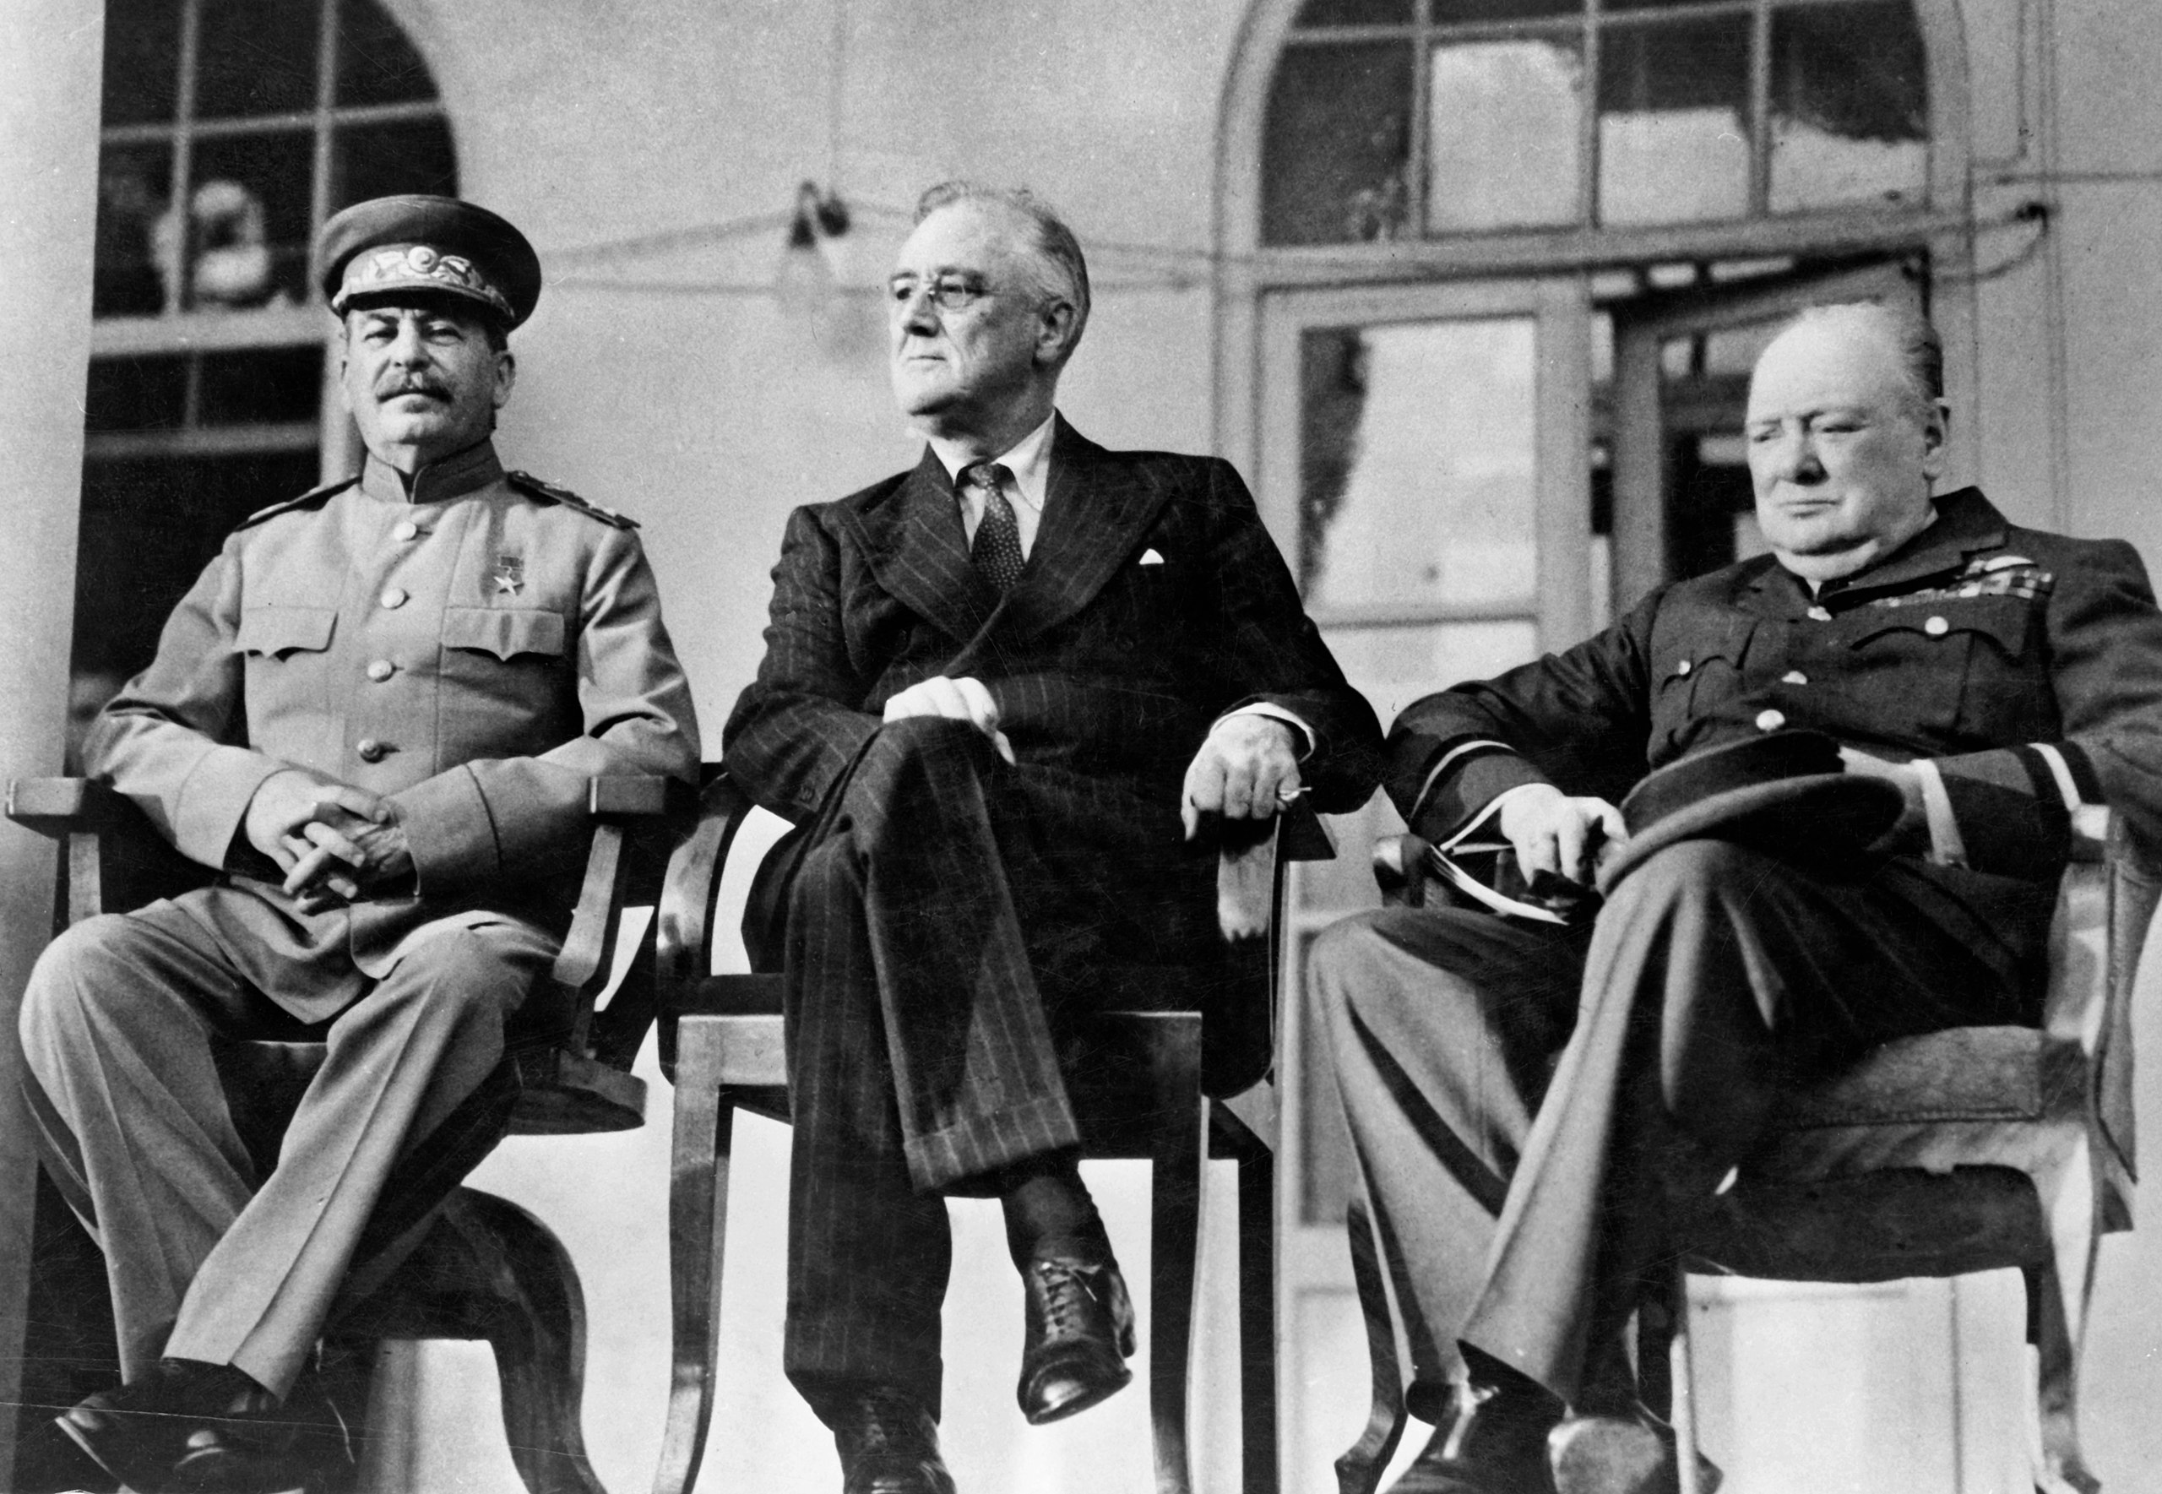
The Tehran Conference
At the Tehran Conference (1943), Roosevelt promised to launch an invasion of France.

Slide 27
D-Day
On “D-Day” (June 6, 1944), the Western Allies opened a second front in Western Europe by landing troops on the beaches of Normandy in the largest amphibious operation in history.

Slide 28
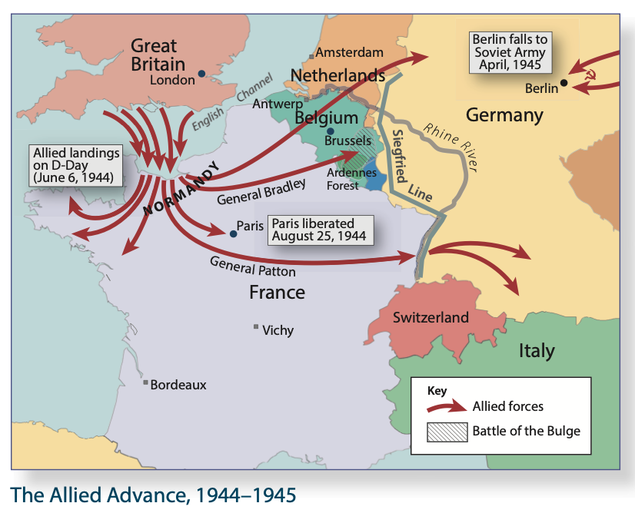
The Western Advance
The Western Allies took Paris and advanced into Germany from the west while Soviet armies advanced from the east.

Slide 29
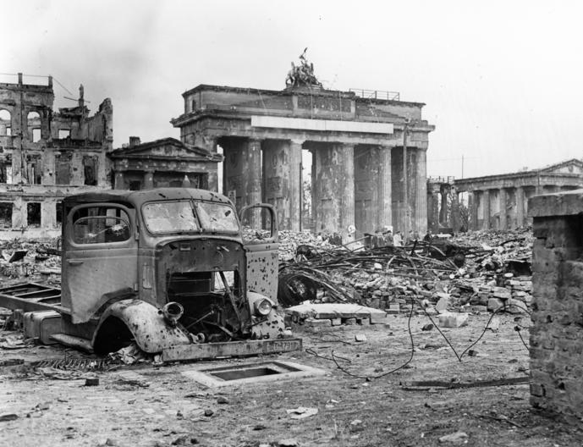
The Collapse of Nazi Germany | The Fall of Berlin
Soviet troops occupied Berlin in April 1945.
Germans fought ferociously in the Battle of Berlin, which led to the destruction of much of their city.
Hitler committed suicide at the end of April and the German army officially surrendered in early May.

Slide 30
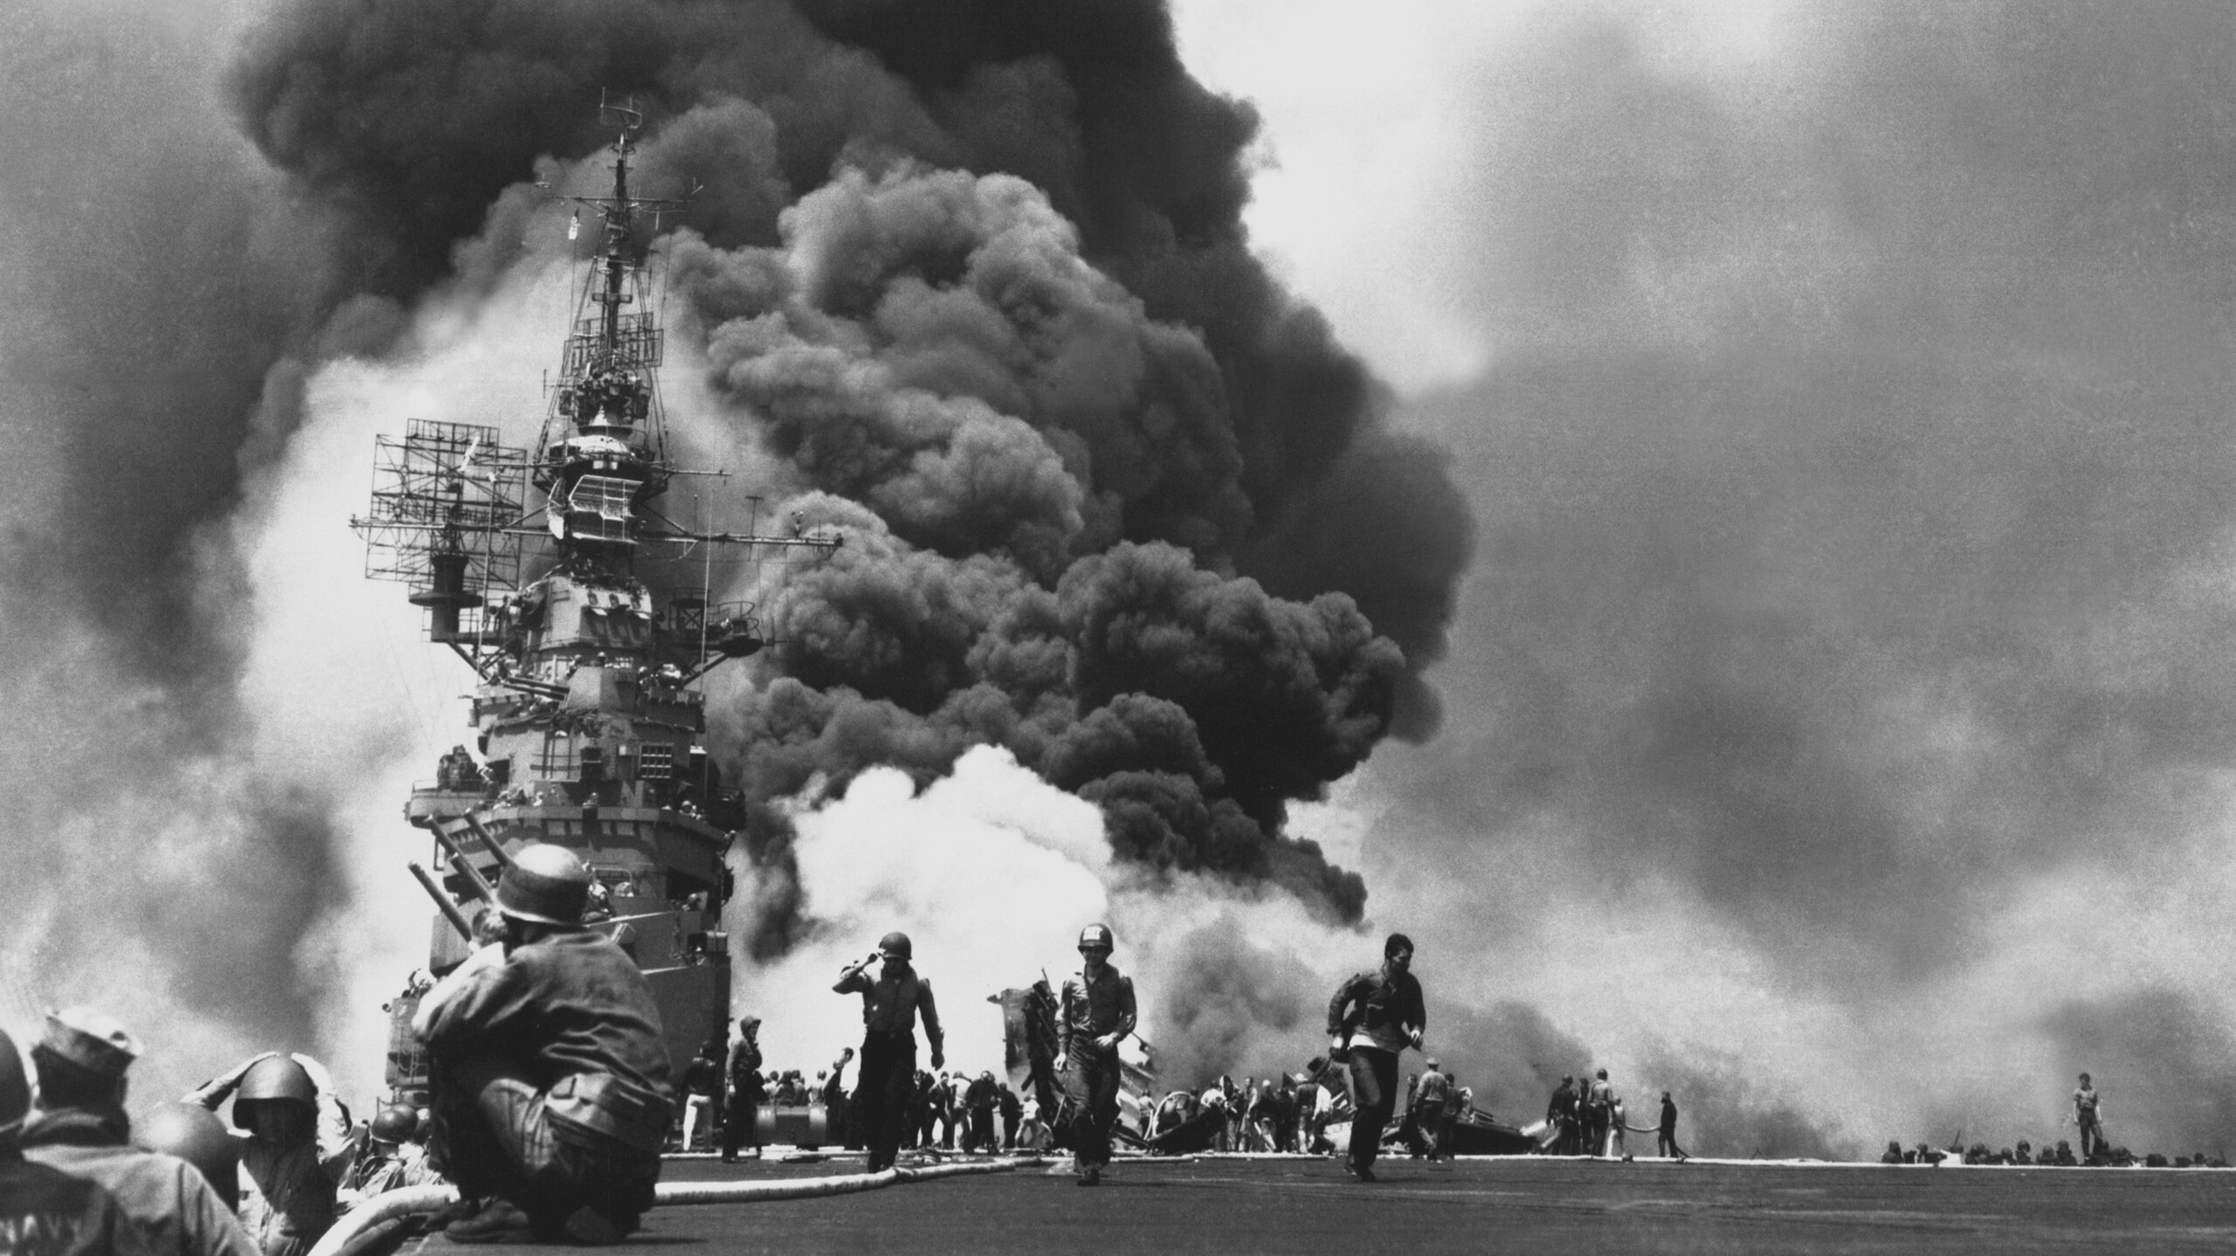
The Pacific Theater: The War against Japan

Slide 31
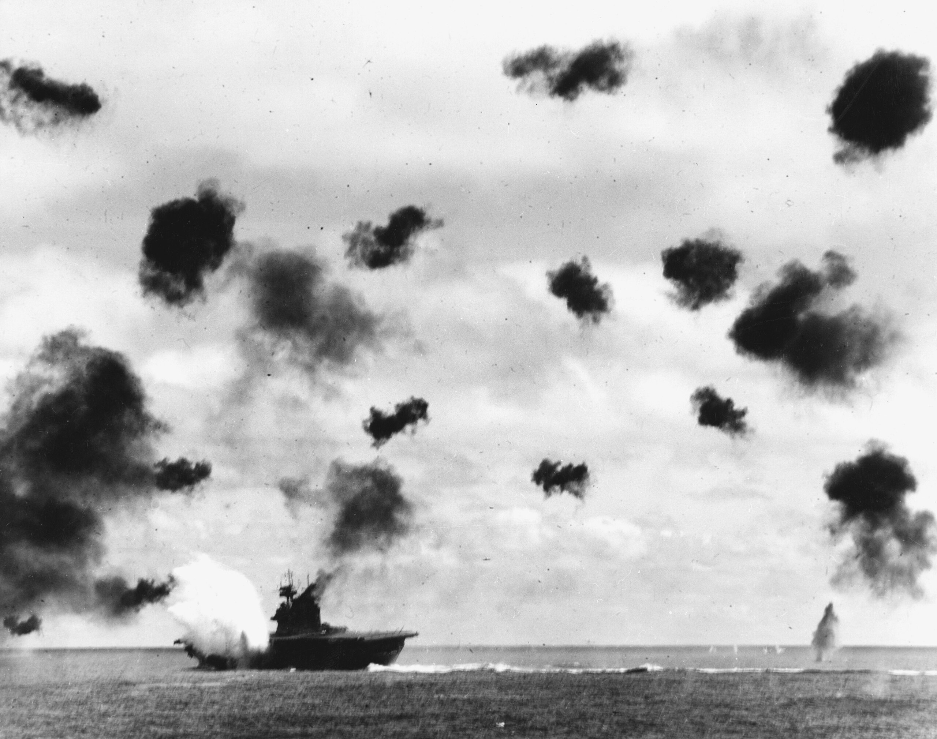
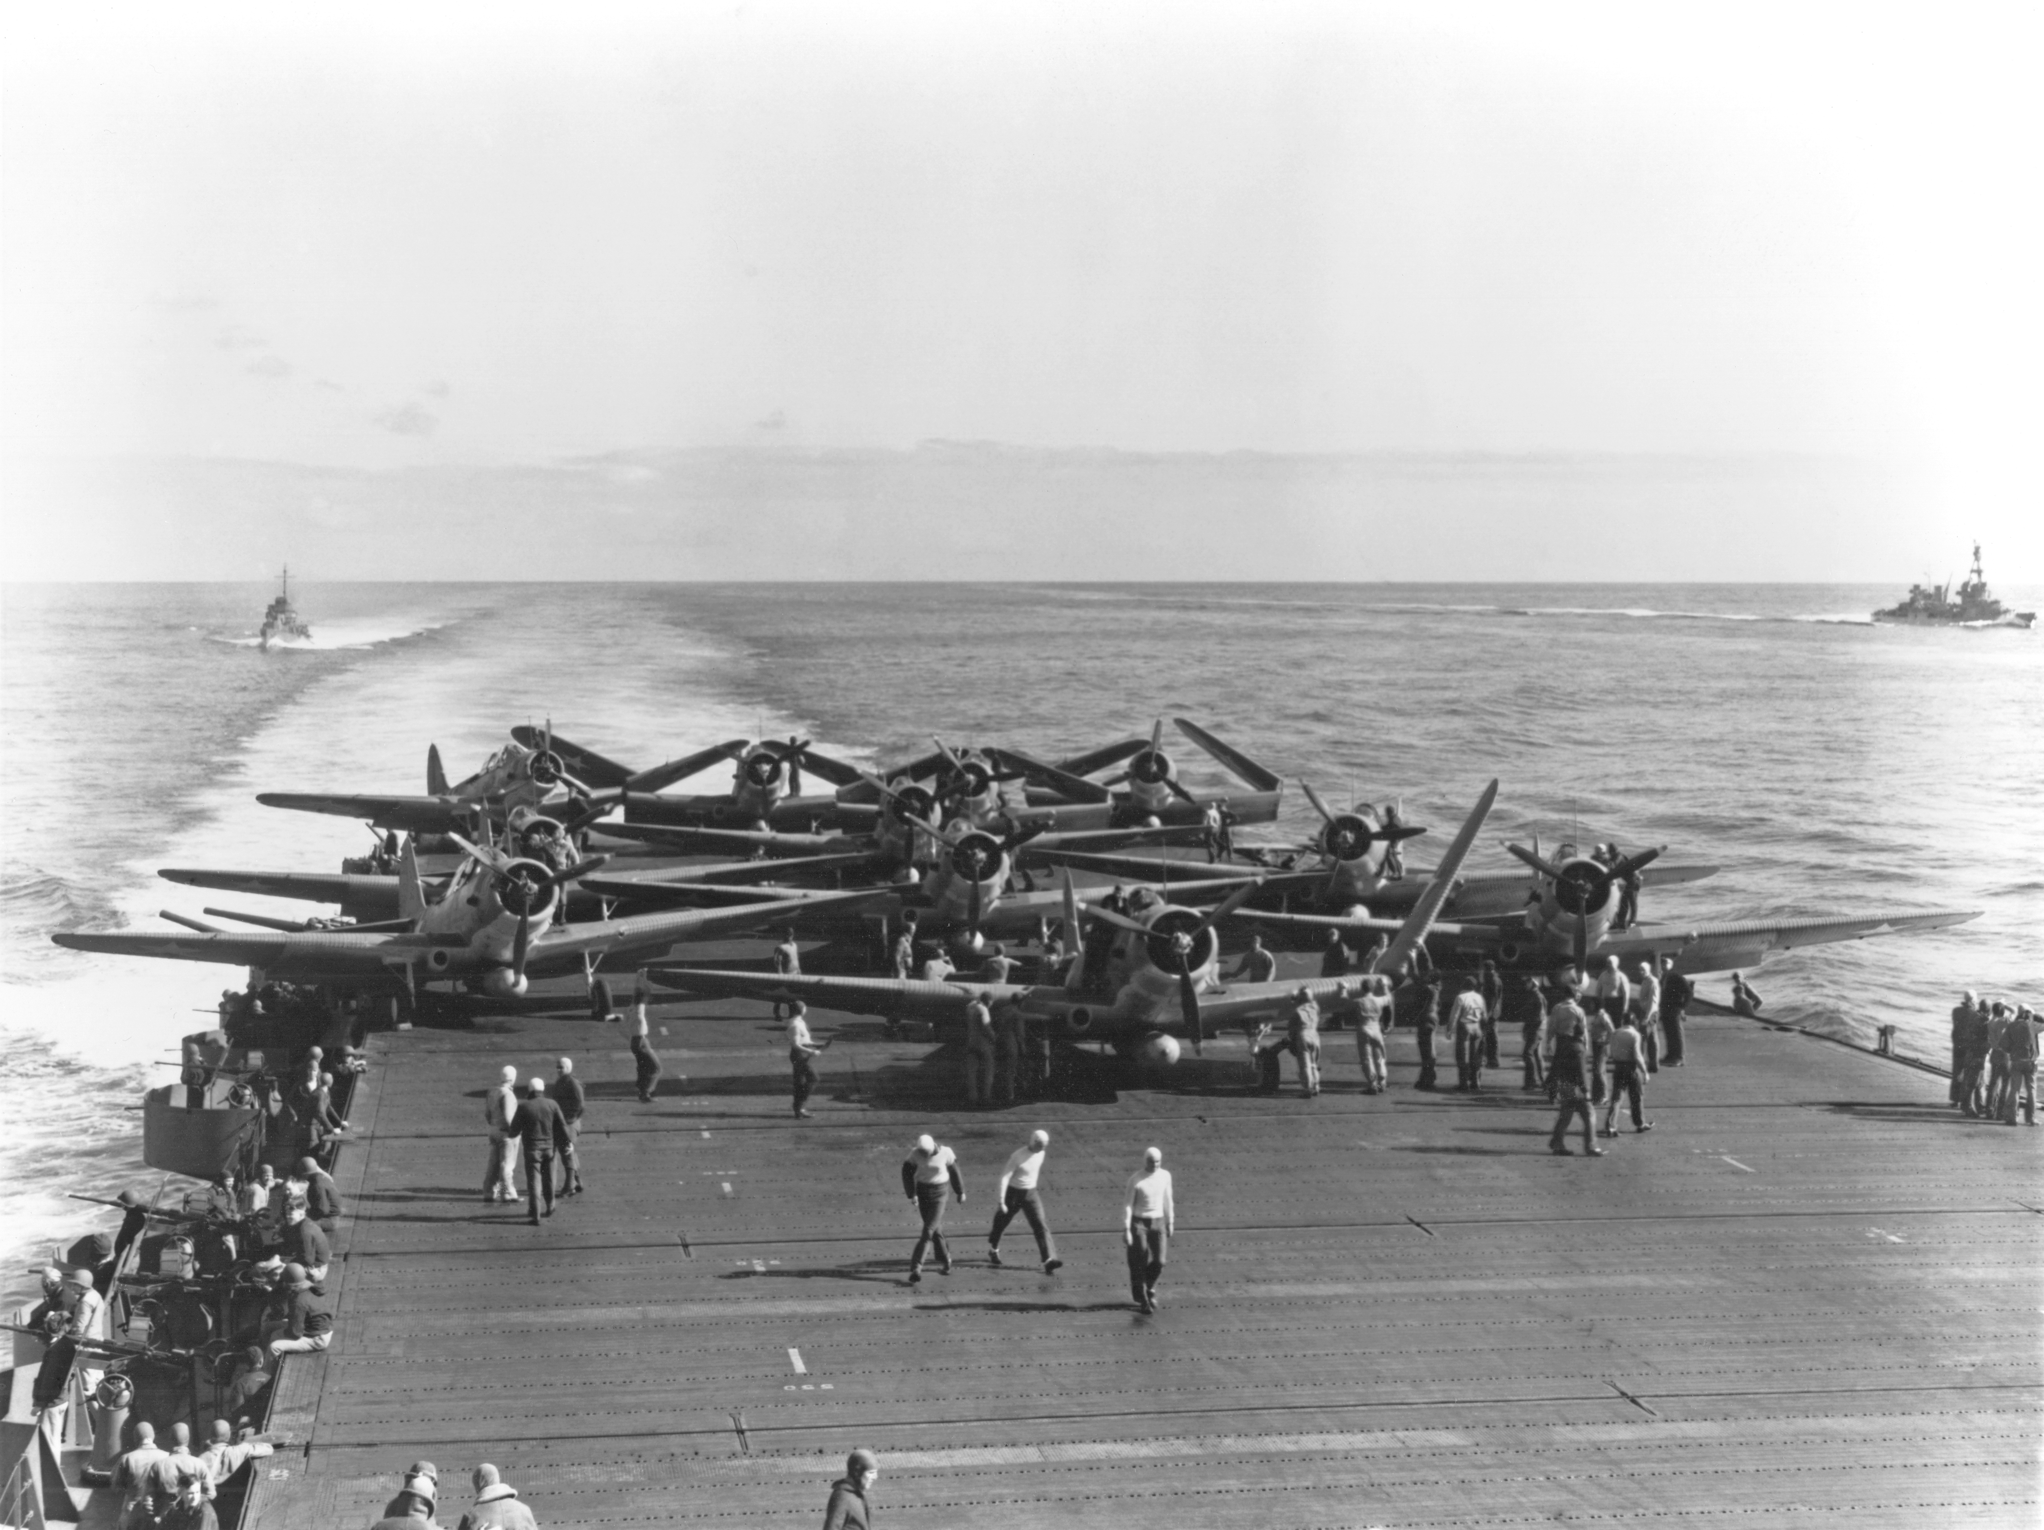
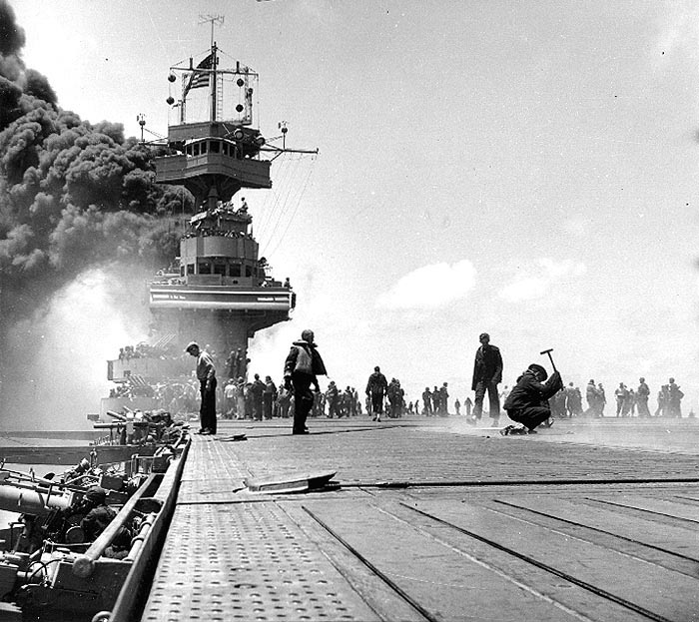
The Battle of Midway
The Battle of Midway (June 1942) was the turning point in the war against Japan. In this naval battle, the United States used its superior intelligence to trick the Japanese and destroy several of their aircraft carriers.

Slide 32
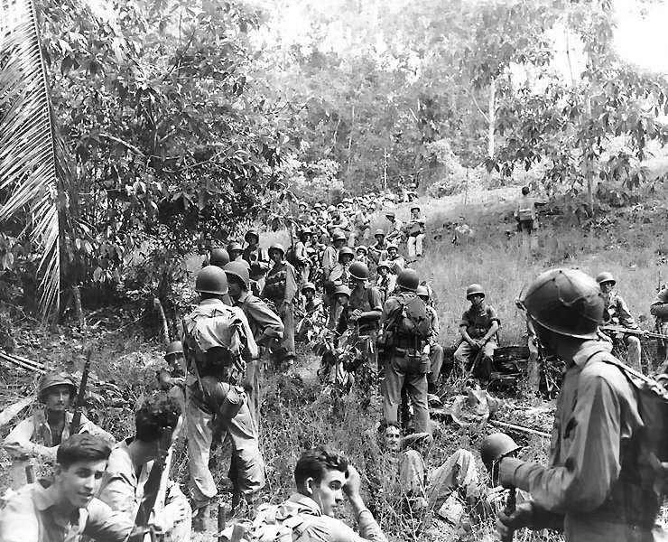
Guadalcanal
The Japanese had occupied islands across the Pacific to create a defensive perimeter around their new empire.
In Guadalcanal, at the south-western end of the Solomon Islands, they began building an airfield to protect their bases and enable their planes to threaten Australia.
Two months after the Battle of Midway, American Marines landed on the island, which they took by surprise.
Despite a series of fierce land and naval attacks, the Japanese failed to retake Guadalcanal.

Slide 33
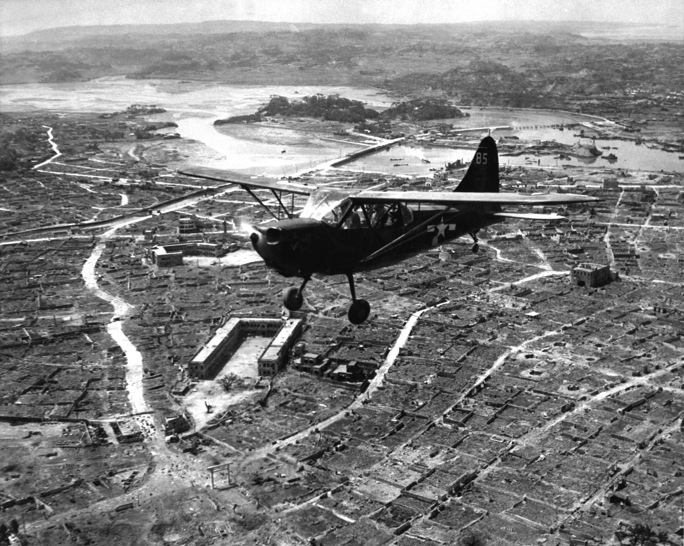
The Japanese Empire Begins to Crumble
Once Germany was defeated, the United States was able to turn its full fury on Japan.
Preparations began for a massive invasion of Japan’s home islands.
In April 1945, American forces landed in Okinawa, a large island only 340 miles from the Japanese home islands.

Slide 34
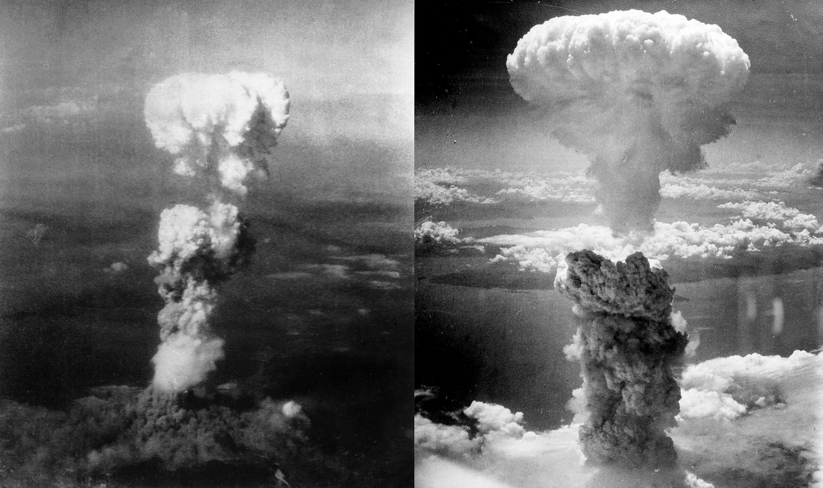
Dawn of the Atomic Age: The Manhattan Project

Slide 35
America Drops Two Atomic Bombs on Japan
The top-secret “Manhattan Project” developed the world’s first atomic bombs.
Two atomic bombs were dropped on Japan in early August 1945 on the cities of Hiroshima and Nagasaki, leading to the Japanese surrender and the end of World War II.

Slide 36
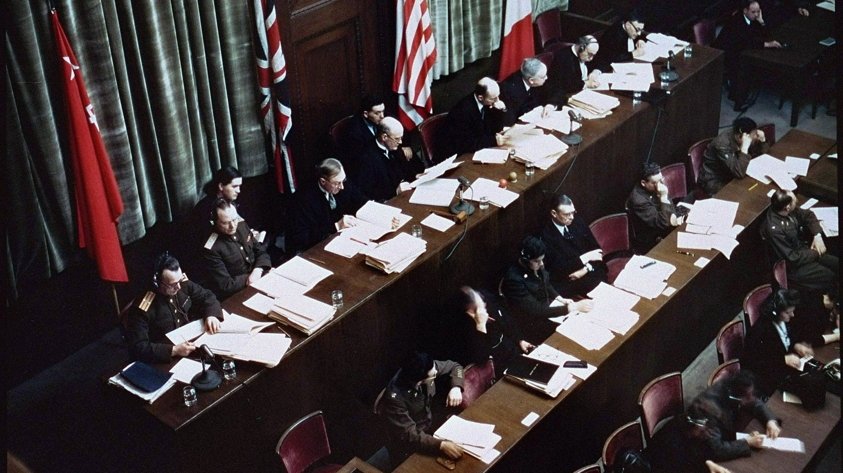
The Consequences of World War II

Slide 37
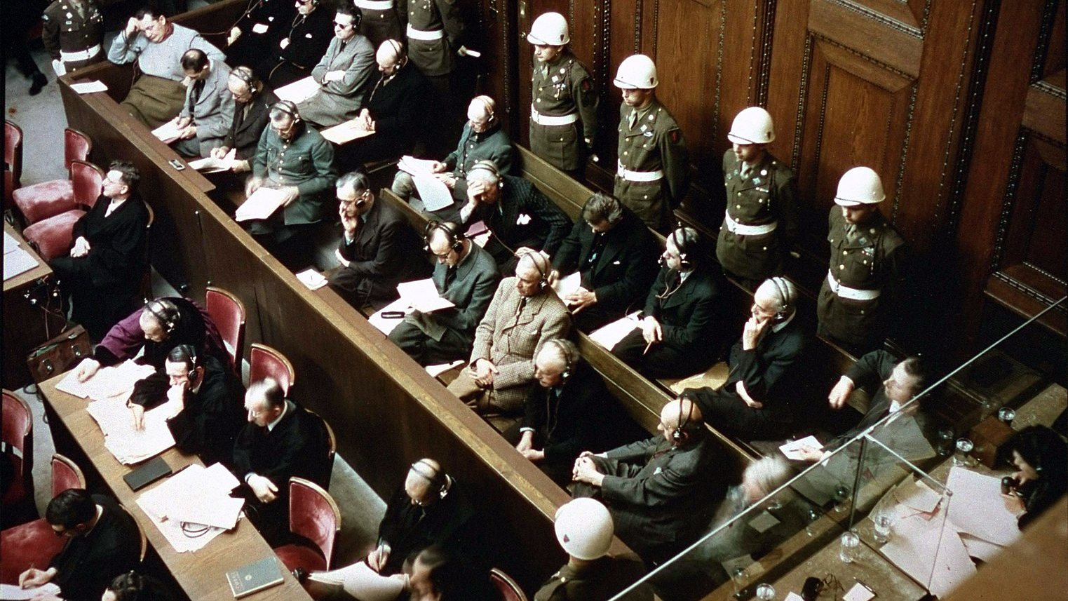
The Nuremberg Trials
Nazi leaders were put on trial at Nuremberg for “crimes against humanity.”

Slide 38
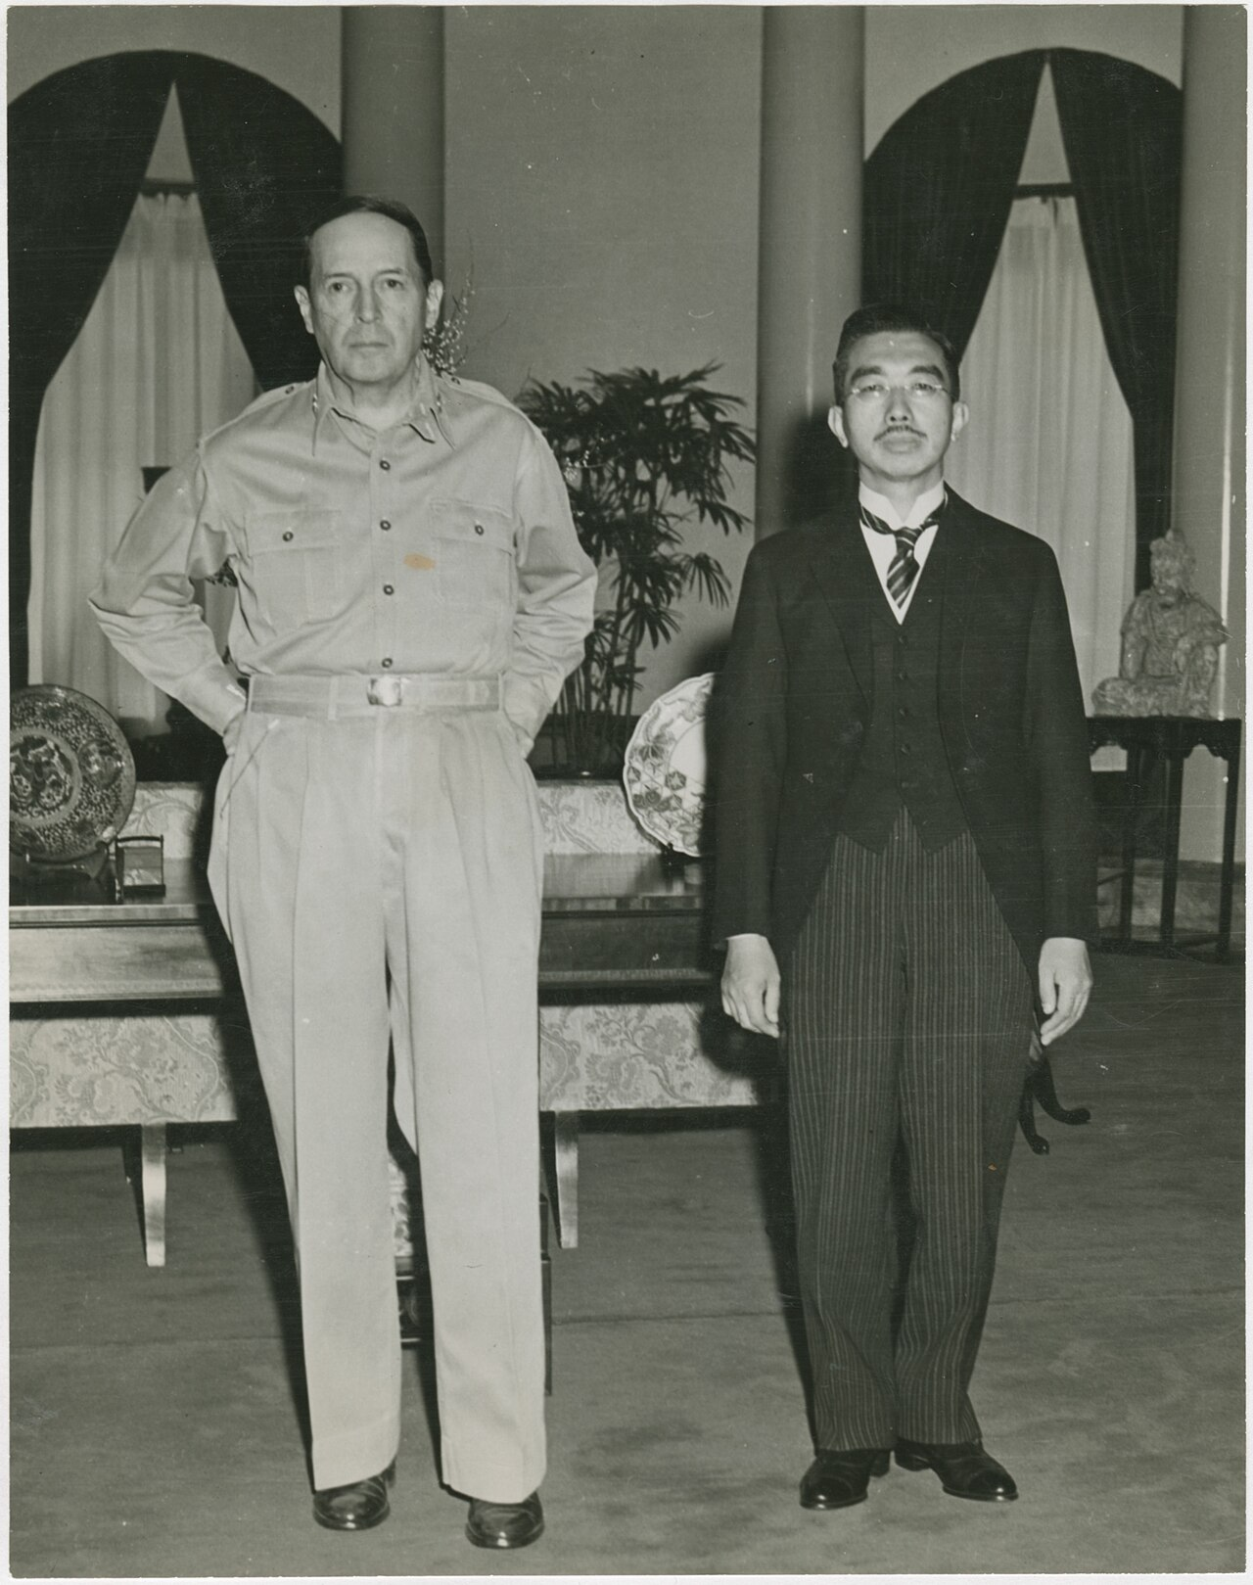
The Occupation of Germany and Japan
Germany was occupied by the United States, Britain, France, and the Soviet Union. Each Allied Power established its own occupation zone.
The United States also occupied Japan. General MacArthur was placed in charge of rebuilding that country.
MacArthur and the Emperor of Japan, Hirohito, at their first meeting, September 1945

Slide 39
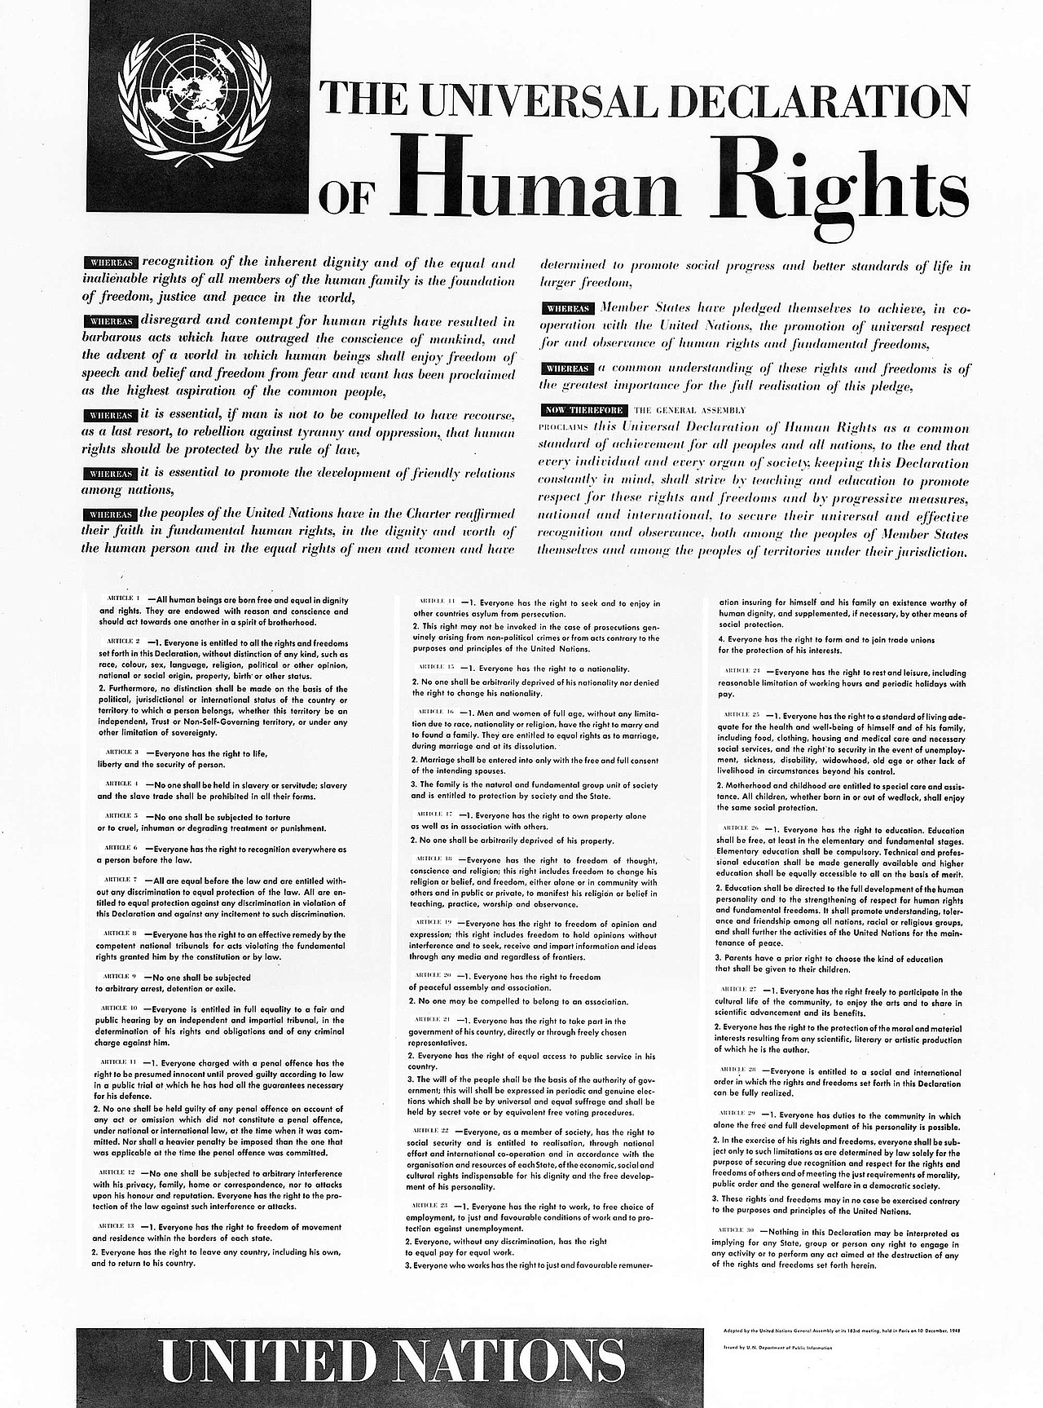
The Birth of the United Nations | The Universal Declaration of Human Rights
The war led to the formation of the United Nations in 1945 and the signing of the Universal Declaration of Human Rights in 1948.

